Slide 1

Model-based support for Decision Making under Deep Uncertainty
Prof. dr. ir. Jan H. Kwakkel
Multi-Actor Systems department
Faculty of Technology, Policy and Management

Slide 2
So what is deep uncertainty?
Deep uncertainty refers to the situation where the various parties to a decision do not know or cannot agree on
The system model that relates actions to consequences
The prior probability distributions to put on the inputs to the system model(s)
Which consequences to consider and their relative importance
Deep uncertainty often involves decisions made over time in dynamic interaction with the system.
Kenneth Arrow first used the term in the late 1990s to characterize the climate change debate
Formal work on dealing with deep uncertainty started in the early 2000s at the RAND Corporation and TU Delft.
Deep uncertainty is also known as radical uncertainty, Knightian uncertainty, or uncertainty proper

Slide 3
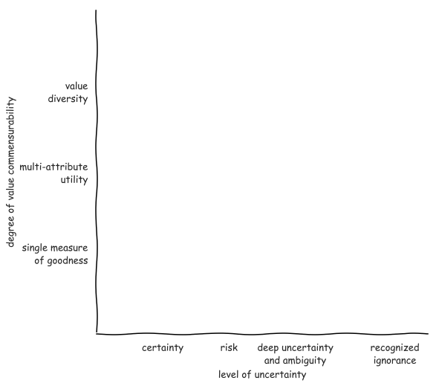
Notes:
Pas op met woord methode
Ontbreken van theorie en effectieve methode

Slide 4
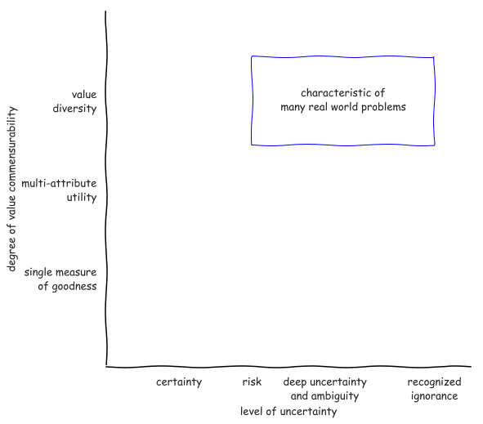
Notes:
Pas op met woord methode
Ontbreken van theorie en effectieve methode

Slide 5
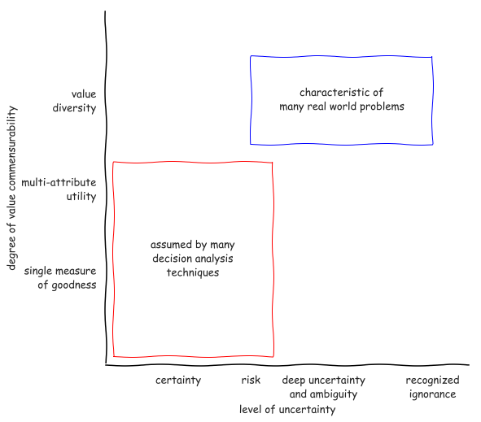
Notes:
Pas op met woord methode
Ontbreken van theorie en effectieve methode

Slide 6
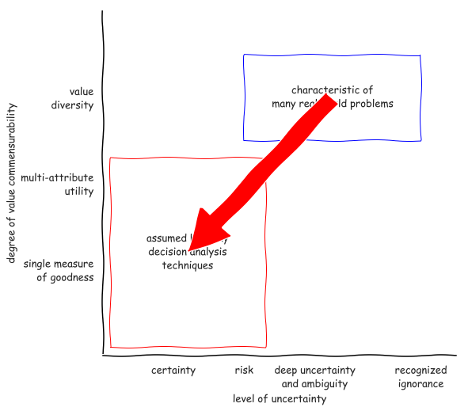
Notes:
Pas op met woord methode
Ontbreken van theorie en effectieve methode

Slide 7
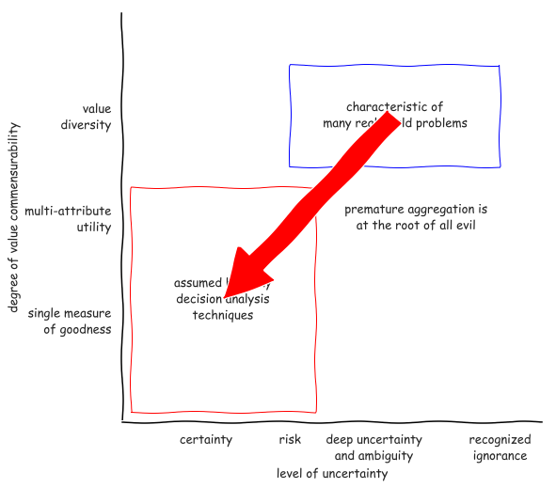
Notes:
Pas op met woord methode
Ontbreken van theorie en effectieve methode

Slide 8
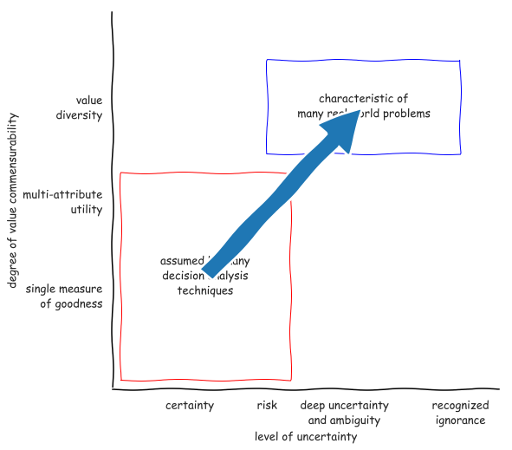
Notes:
Pas op met woord methode
Ontbreken van theorie en effectieve methode

Slide 9
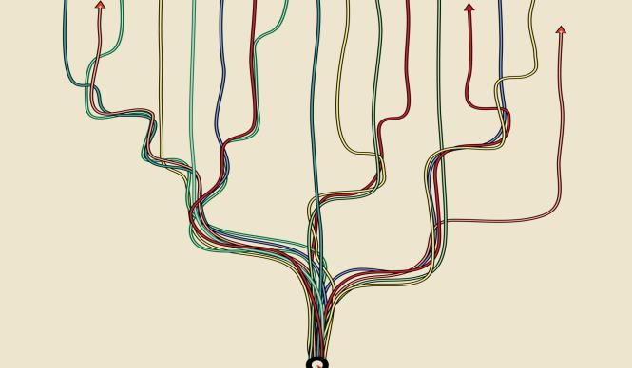
Why use models?
Argument from complexity
supplement human reasoning
sensitivity to initial conditions
Argument from uncertainty
When confronted with uncertainty, instead of making an assumption, explore the consequences of alternative assumptions systematically to identify differences that make a difference
Notes:
Multiplicity of legitimate perspectives
Does l’esprit de geometrie have a place?

Slide 10
Decision-making under deep uncertainty
Decision aiding – the aim of decision advise is to facilitate learning about a problem and potential courses of action, not to dictate the right solution. This entails a shift from a priori to a posteriori decision analysis.
Adaptive planning – plans should be designed from the outset to be adapted over time in response to how the future is unfolding
Exploratory scenario thinking– the future is uncertain and cannot be probabilistically constrained, we need systematic what-if analysis of the future which serves as a test bed for candidate strategies

Slide 11
Aiding decision making

Slide 12

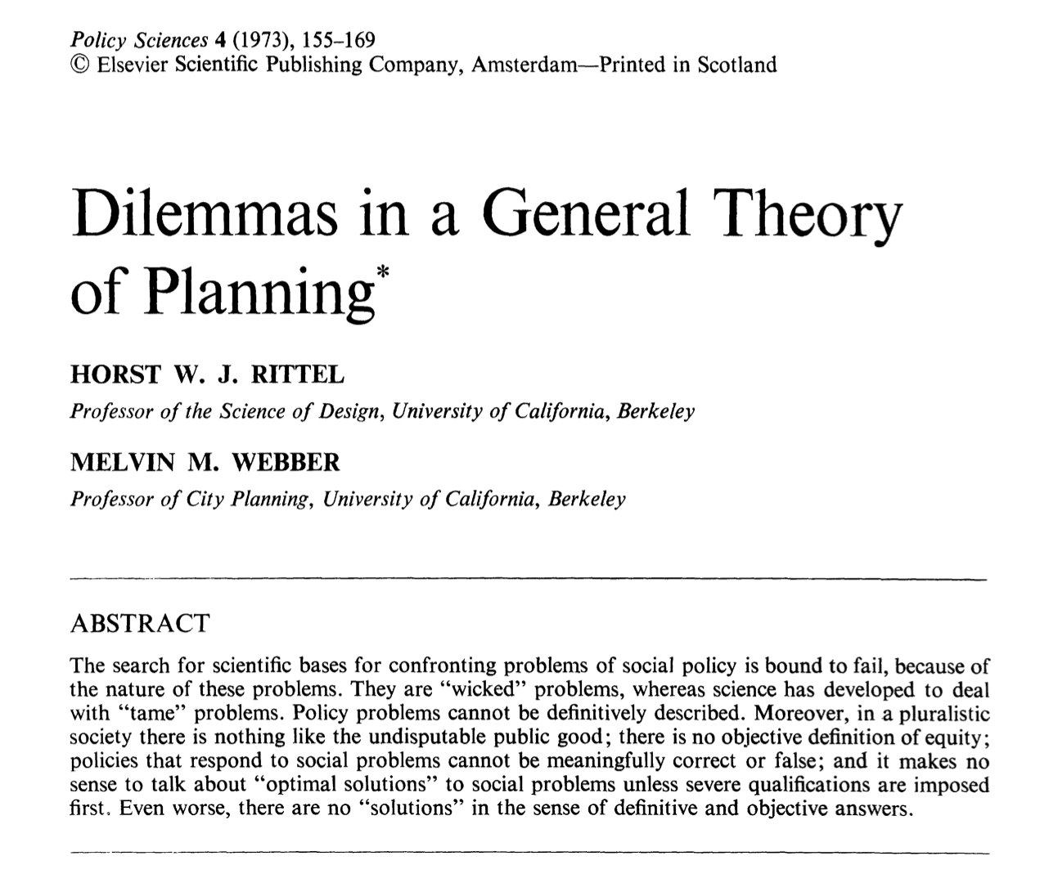
What is the role of models in decision making?
Notes:
The task of an adaptive organism is to find the difference between an existing state and a desired state and then find the correlating process that will erase the difference.

Slide 13

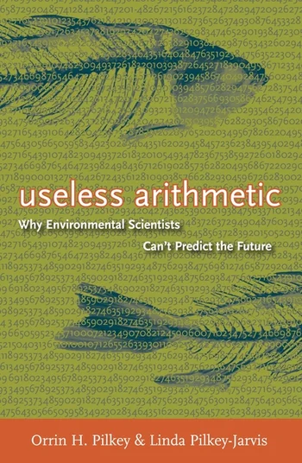
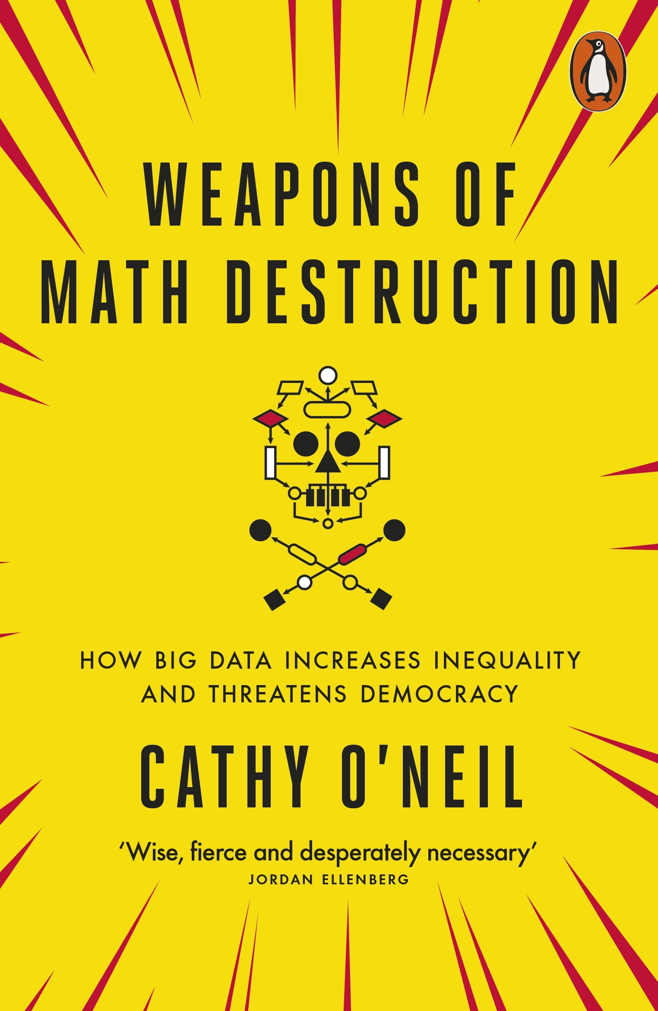

Slide 14
Adaptive planning

Slide 15
Adaptation pathways
Action
A
Time horizon
100
years
Action
B
Pathway
Costs
Benefits
Co
-
benefits
Current
1
+++
+
0
situation
2
+++++
0
0
Action
C
3
+++
0
0
Action
D
4
+++
0
0
Changing conditions
5
0
0
-
0
6
++++
0
-
Time low
-
end scenario
10
70
80
90
100
7
+++
0
-
0
10
100
8
+
+
-
-
-
Time high
-
end scenario
70
80
90
9
++
+
-
-
-
Years
Transfer station to new
policy
action
Adaptation Tipping Point of a
policy action
(
Terminal
)
Policy action
effective

Slide 16
Exploratory scenario thinking

Slide 17
Often, more information can be captured in an ensemble of alternative plausible models than can be captured by any individual model.
Bankes (2002) 10.1073􏰅pnas.092081399

Slide 18
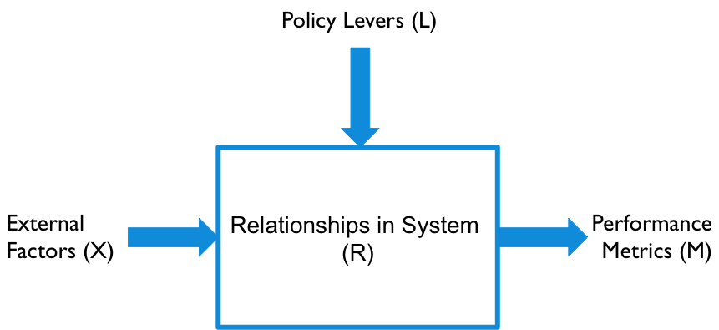
XLRM framework

Slide 19
Running a model as a function
X : uncertainties
Model structure uncertainties as well as exogenous forces
A point in uncertainty space is called a scenario
L : levers
A point in lever space is called a policy
Policies to be tested over the uncertainties
M : outcomes
Outcomes of interest

Slide 20
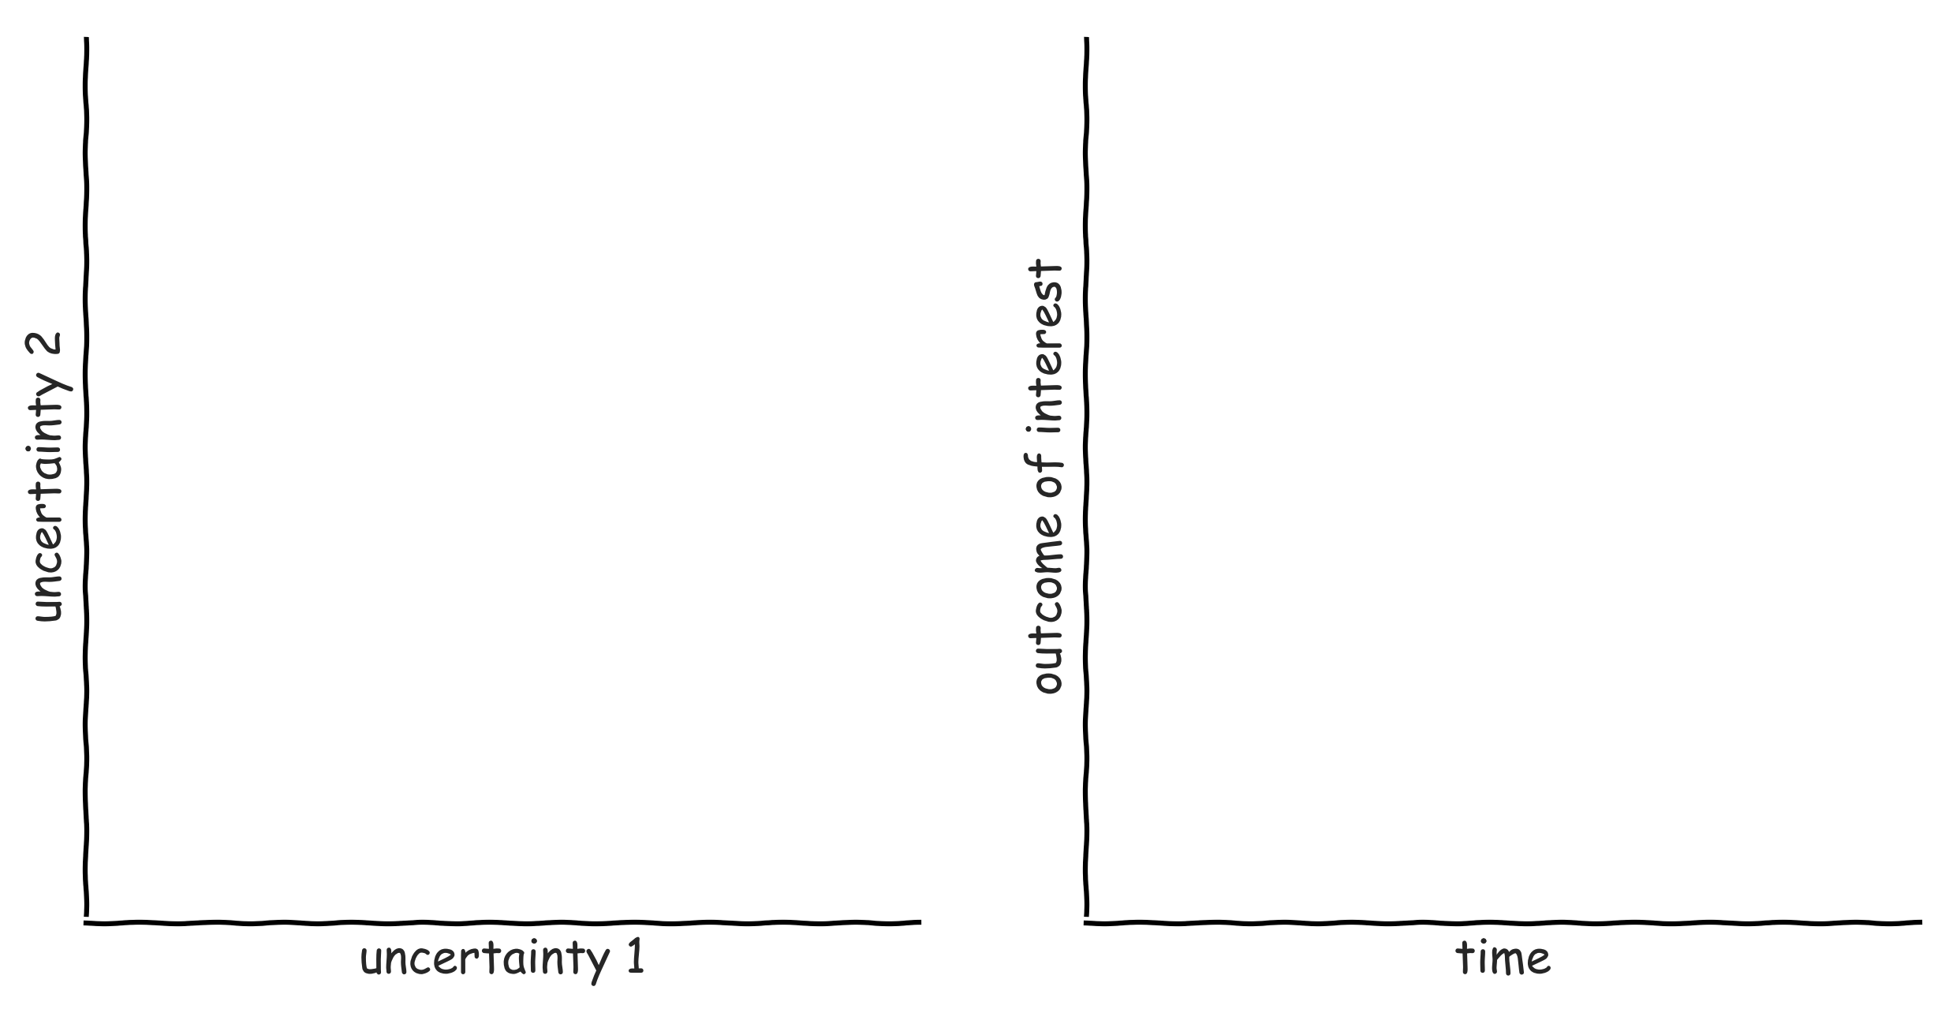
Exploratory modelling in a nutshell

Slide 21
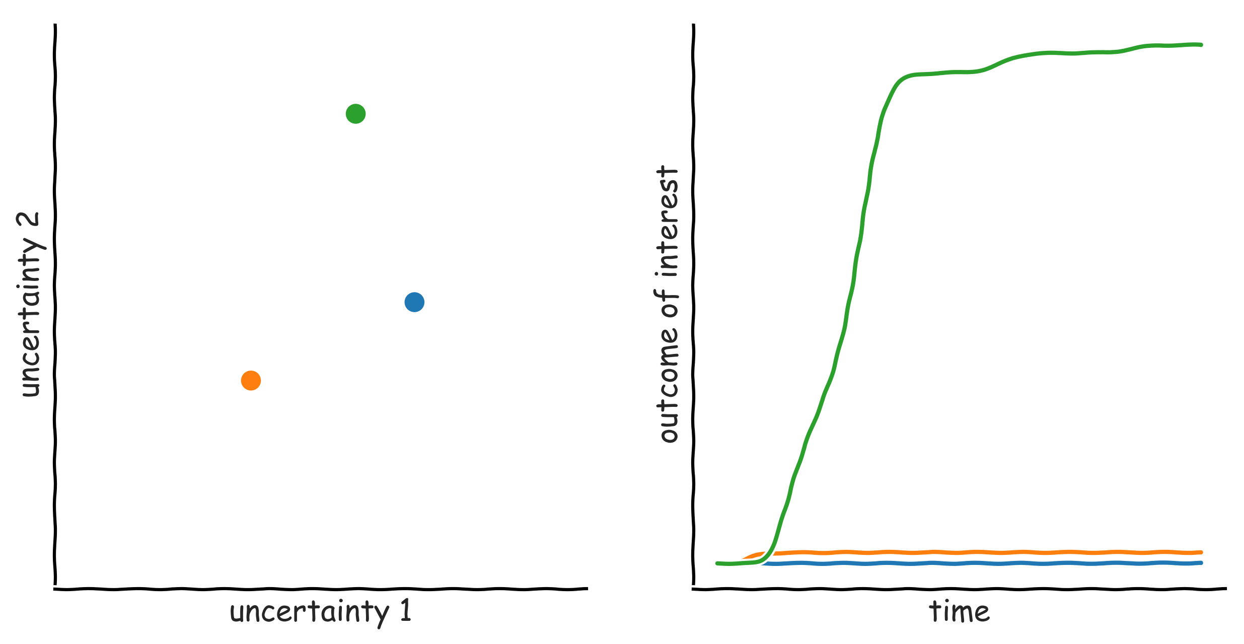
Exploratory modelling in a nutshell

Slide 22
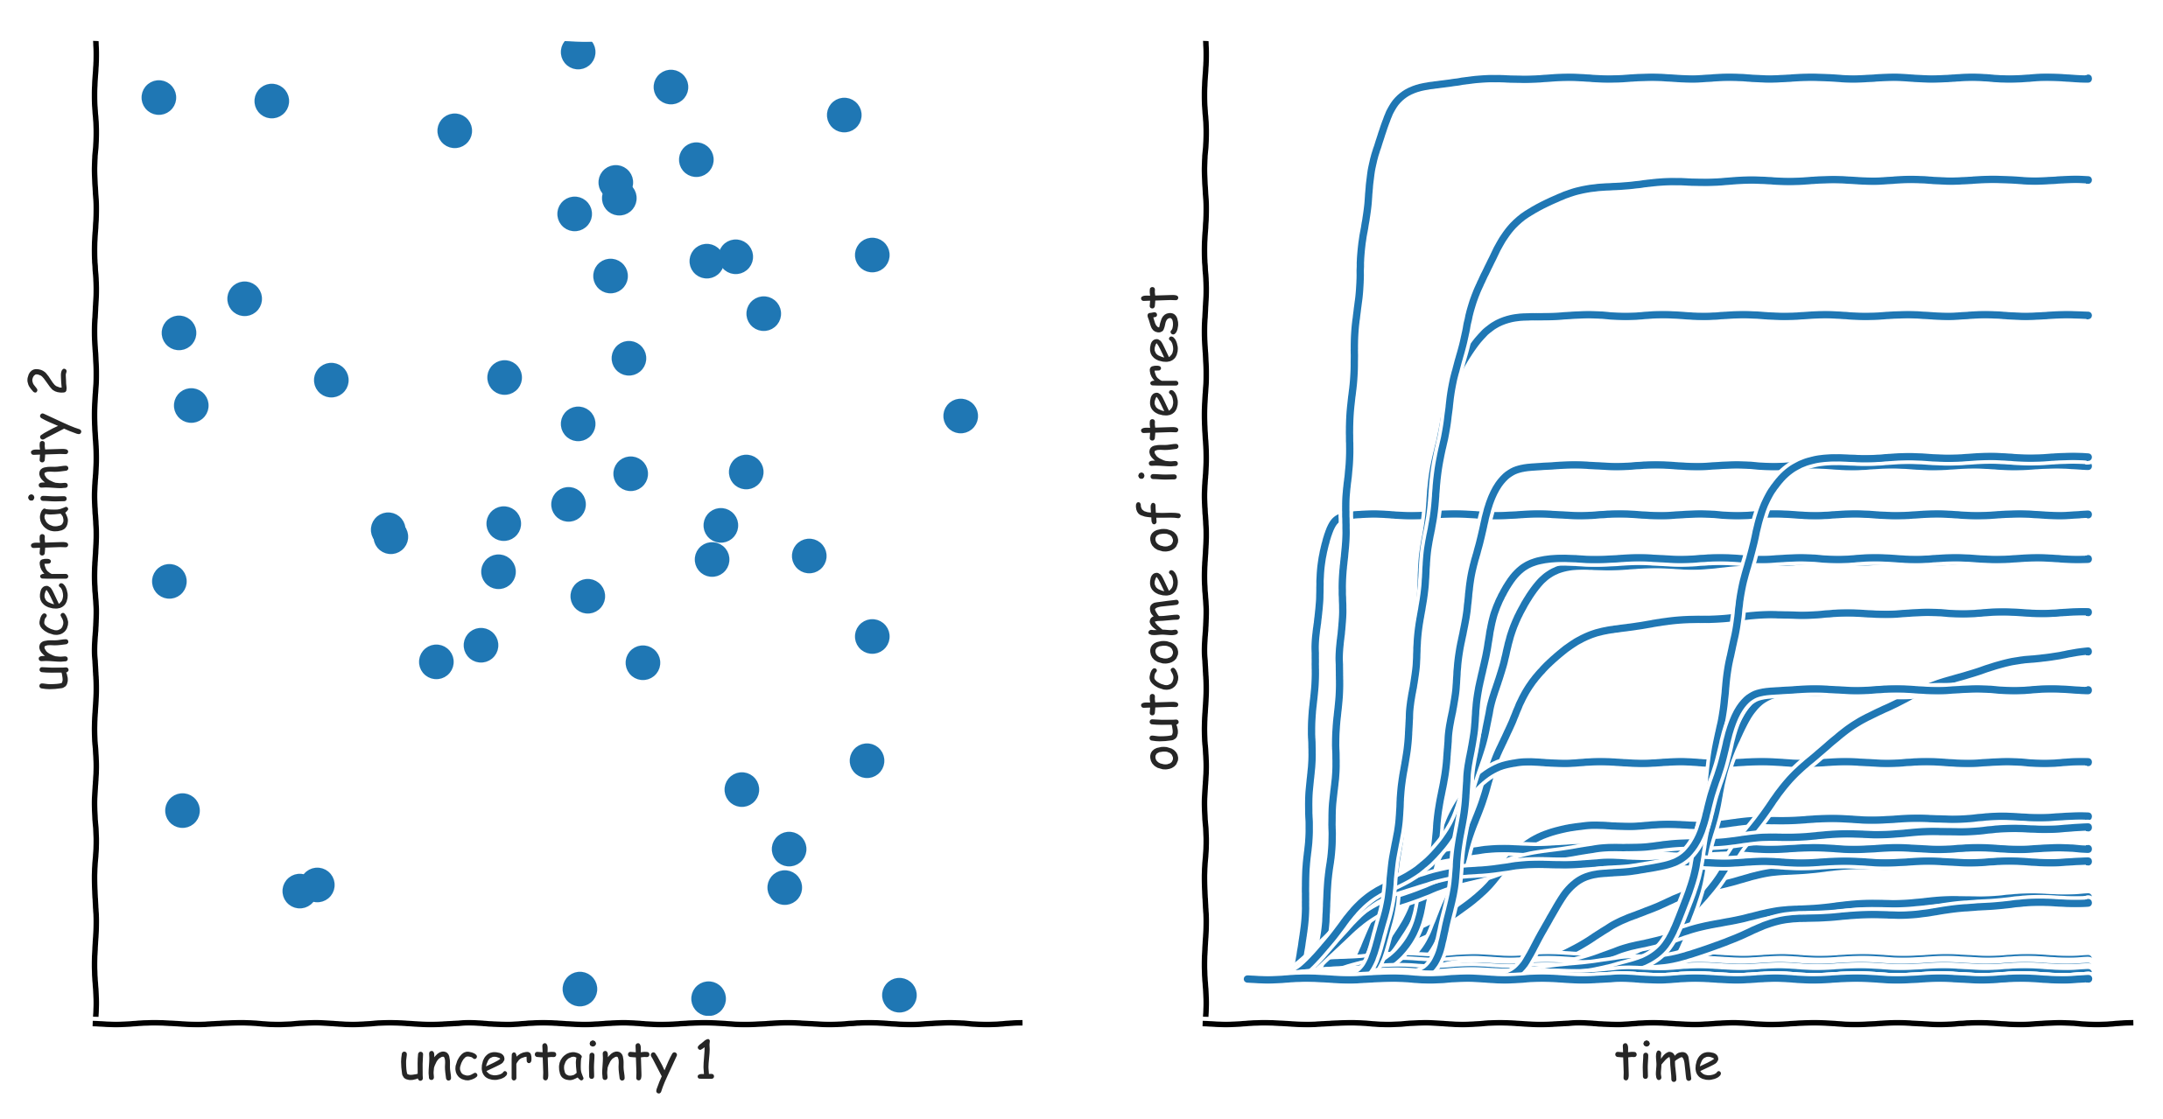
Exploratory modelling in a nutshell

Slide 23
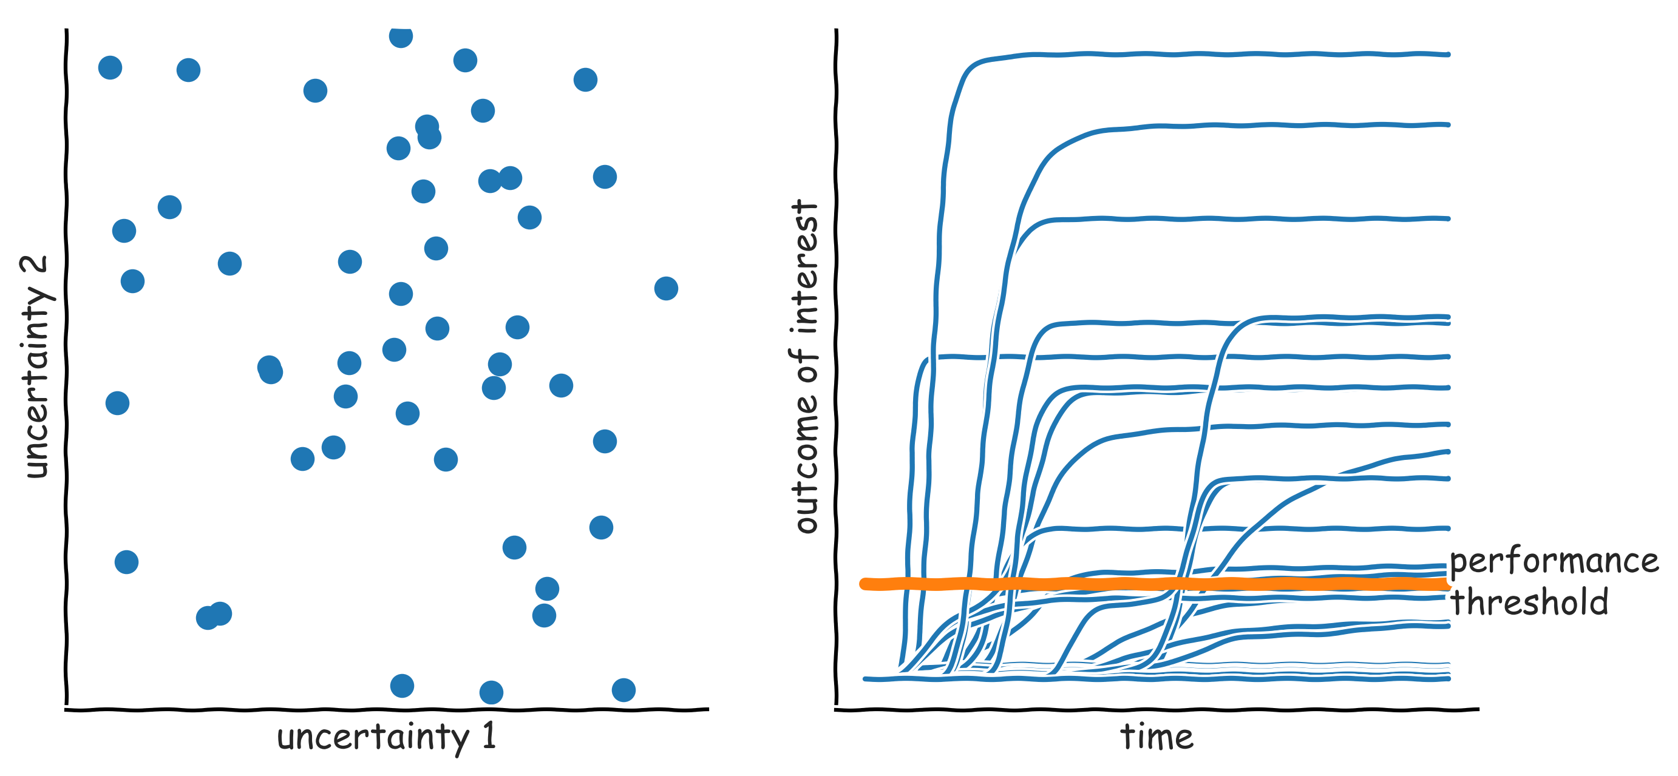
Exploratory modelling in a nutshell: scenario discovery

Slide 24
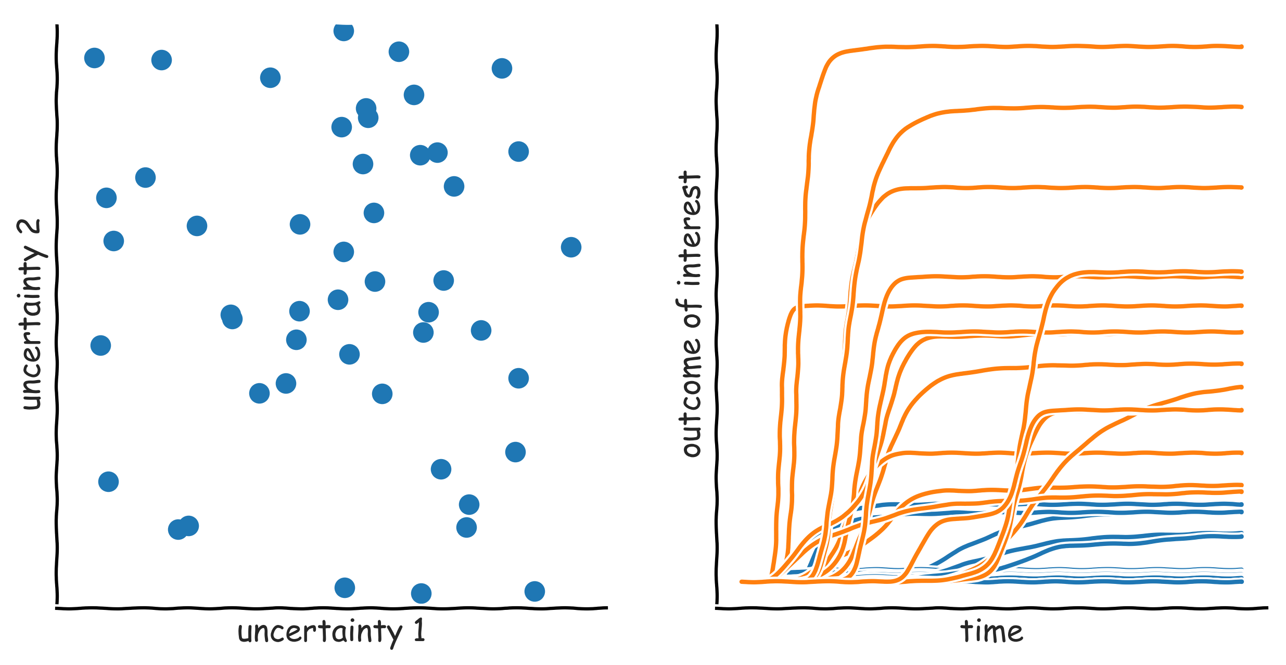
Exploratory modelling in a nutshell: scenario discovery

Slide 25
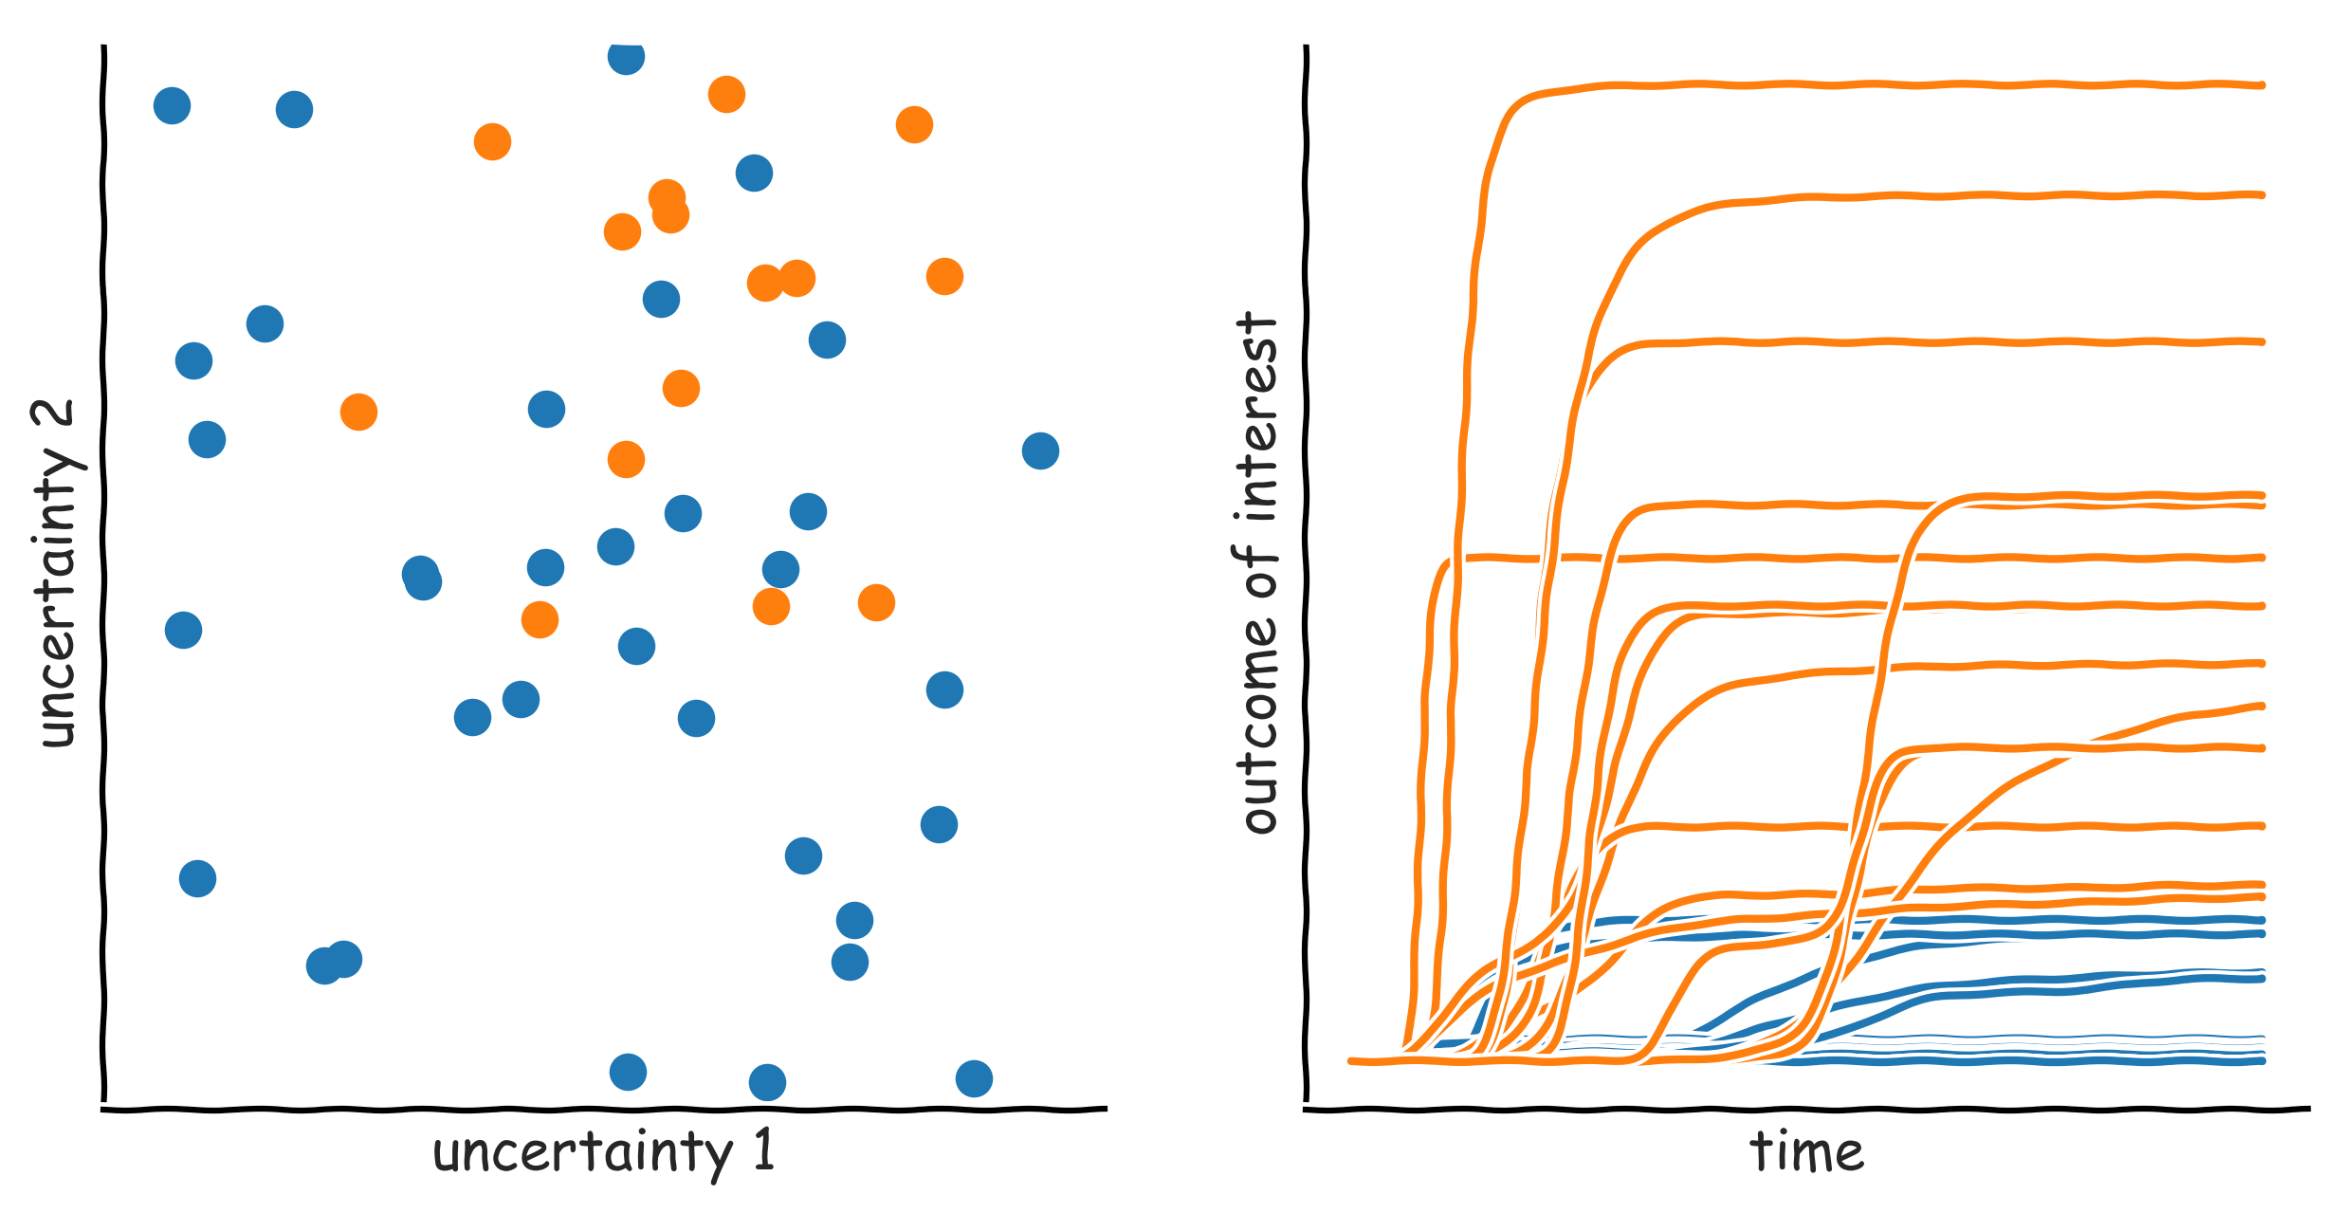
Exploratory modelling in a nutshell: scenario discovery

Slide 26
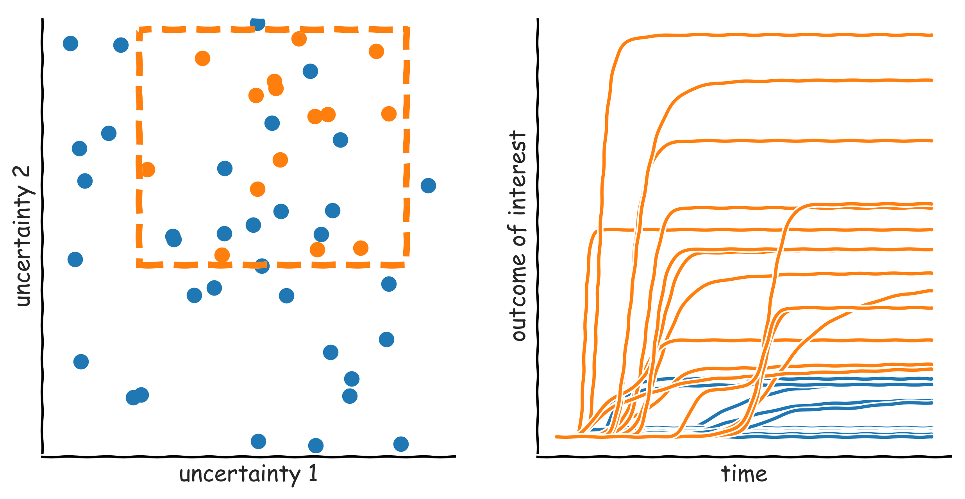
Exploratory modelling in a nutshell: scenario discovery

Slide 27
Manual scenario discovery exercise

Slide 28
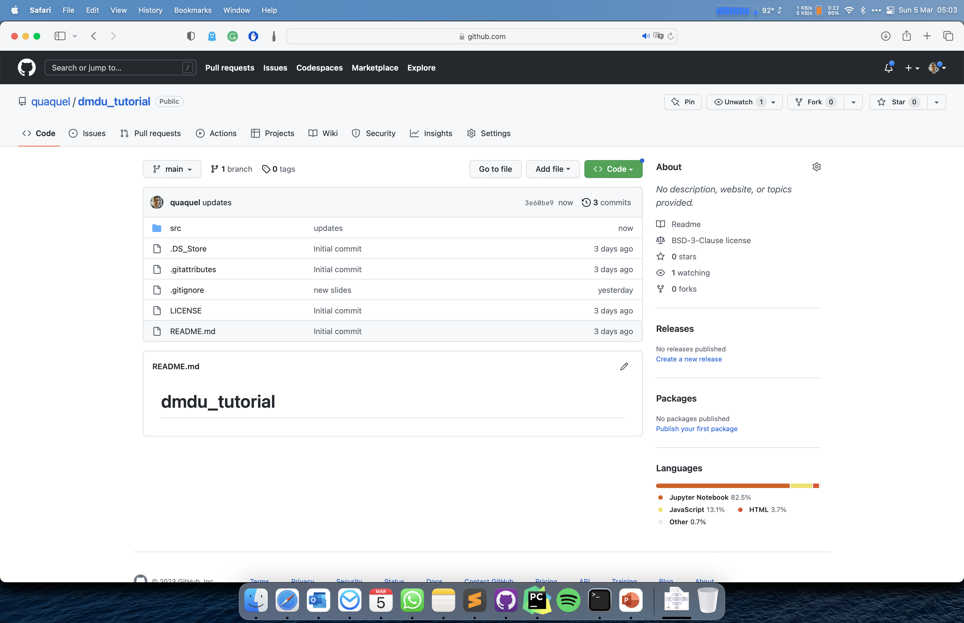
Click and download as zip file

Slide 29
Unzip the downloaded file
Open manual_scenario_discovery.html

Slide 30
Scenario Discovery

Slide 31
Subspace partitioning
Problem: find an (orthogonal) subspace in the model input space, which has a high concentration of cases of interest
Rule induction problem
Regression vs. (binary) classification
Rule induction algorithms
Classification and Regression Trees (CART)
Patient Rule Induction Algorithm (PRIM
Various other more specialized possibilities

Slide 32
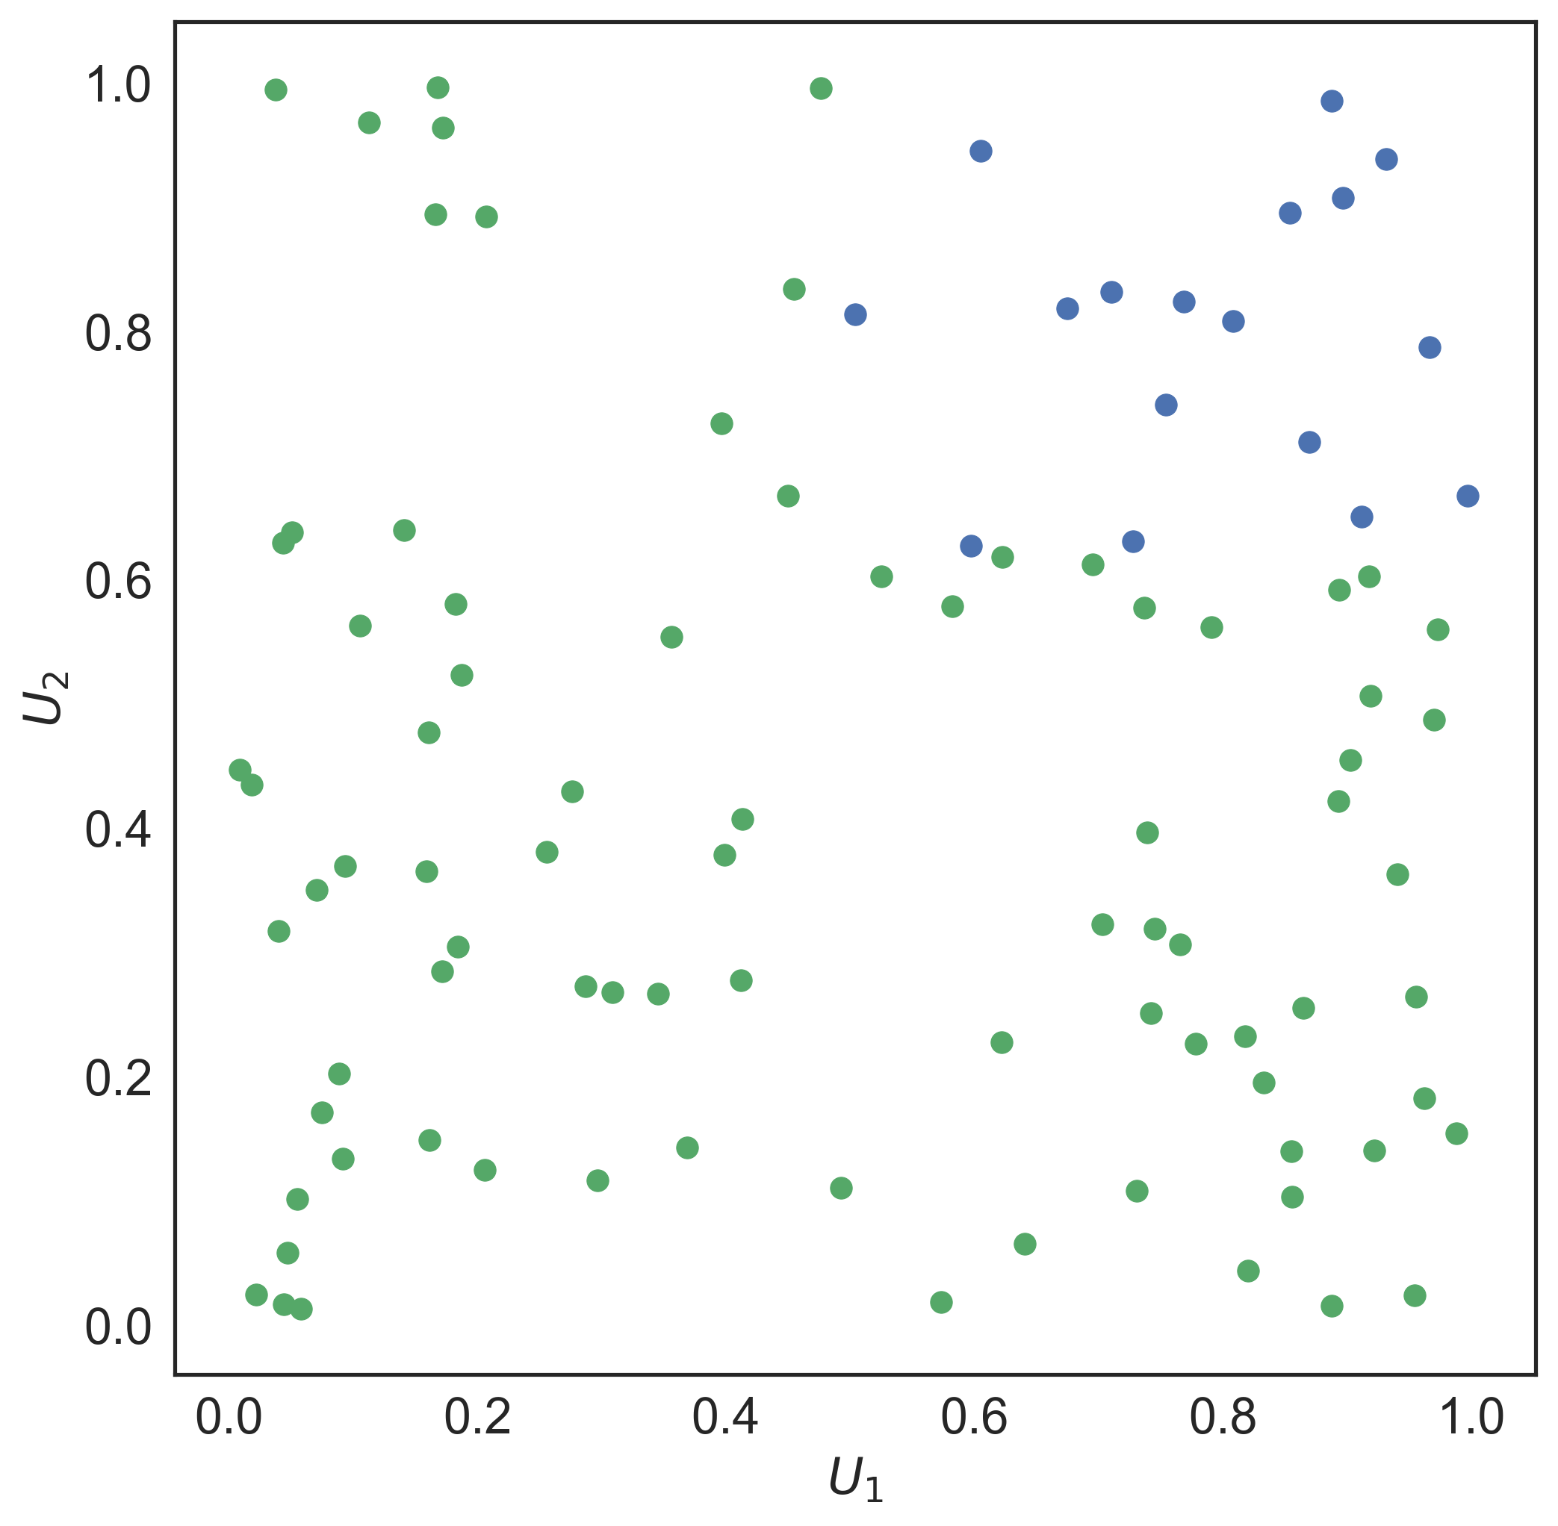
PRIM

Slide 33
PRIM
Lenient hill-climbing optimization algorithm
Each step in the optimization is stored → peeling trajectory
Coverage: fraction of cases of interest within the box
Density: fraction of cases in the box which is of interest
Interpretability: number of restricted uncertainties
Quasi p-values: one sided binomial test, proxy for statistical significance of each restricted uncertainty in isolation
Resampling statistic: do random subsets of the same dataset produce essentially the same box?

Slide 34
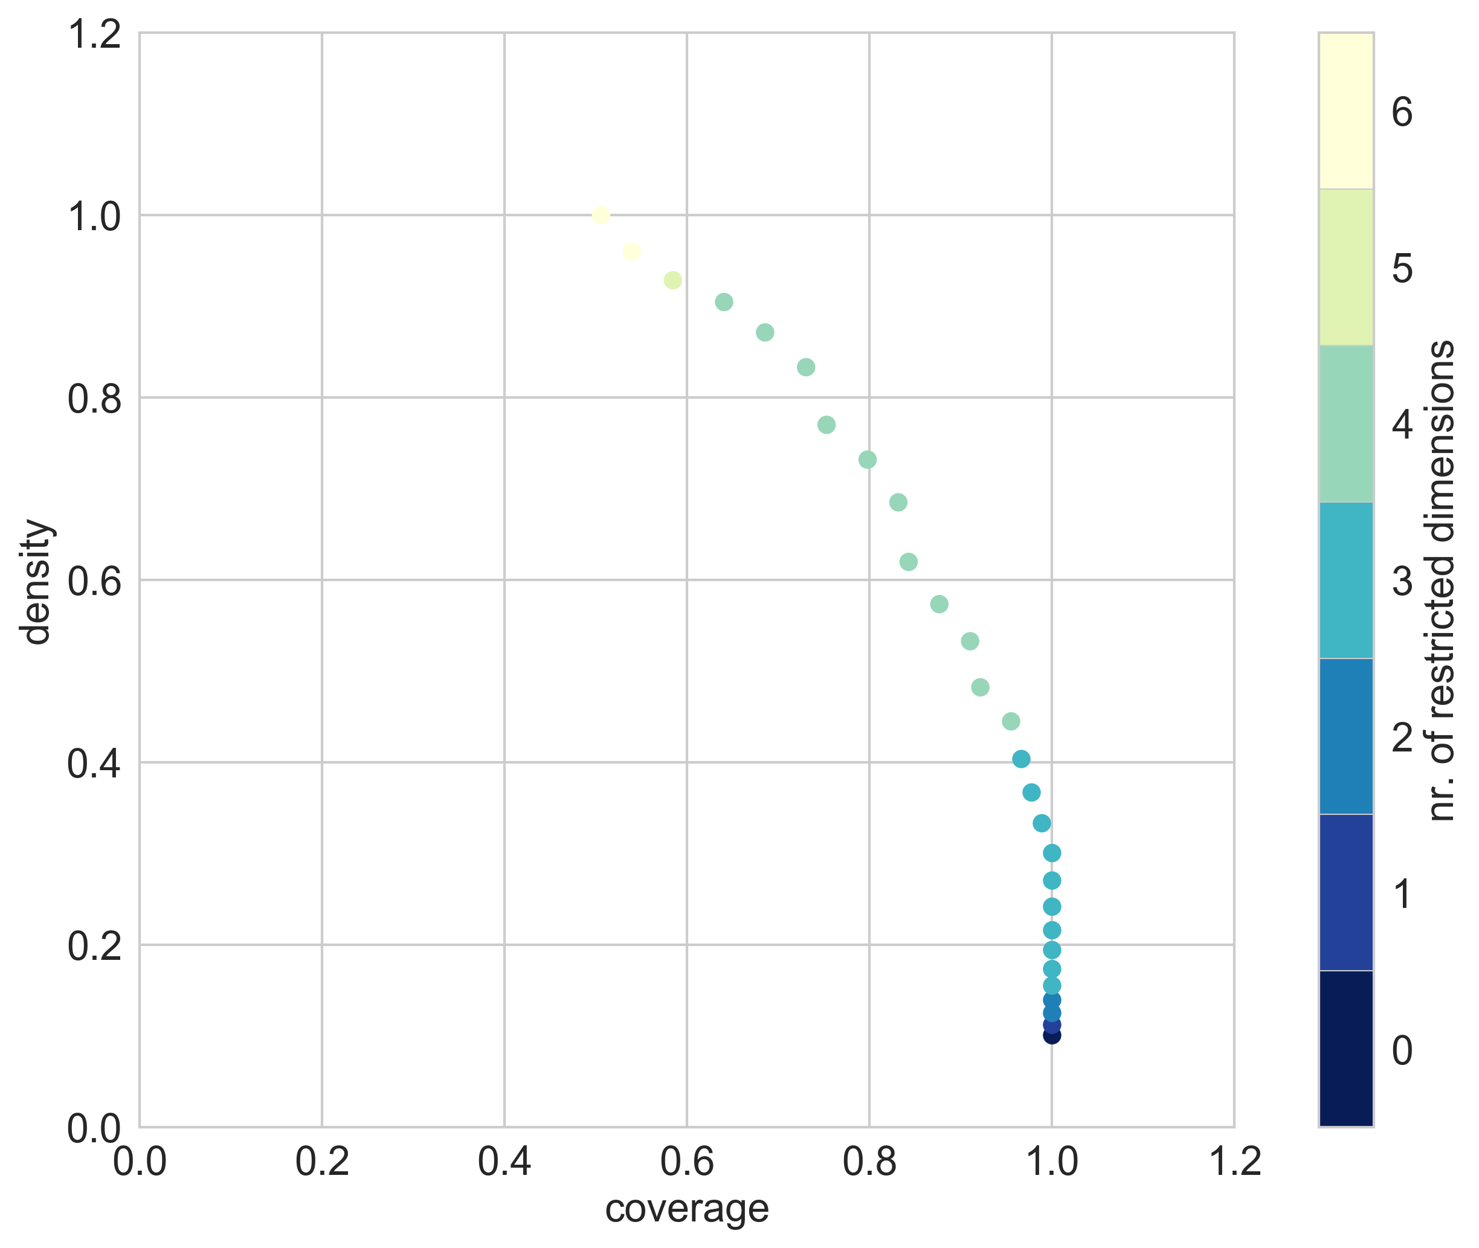

Slide 35
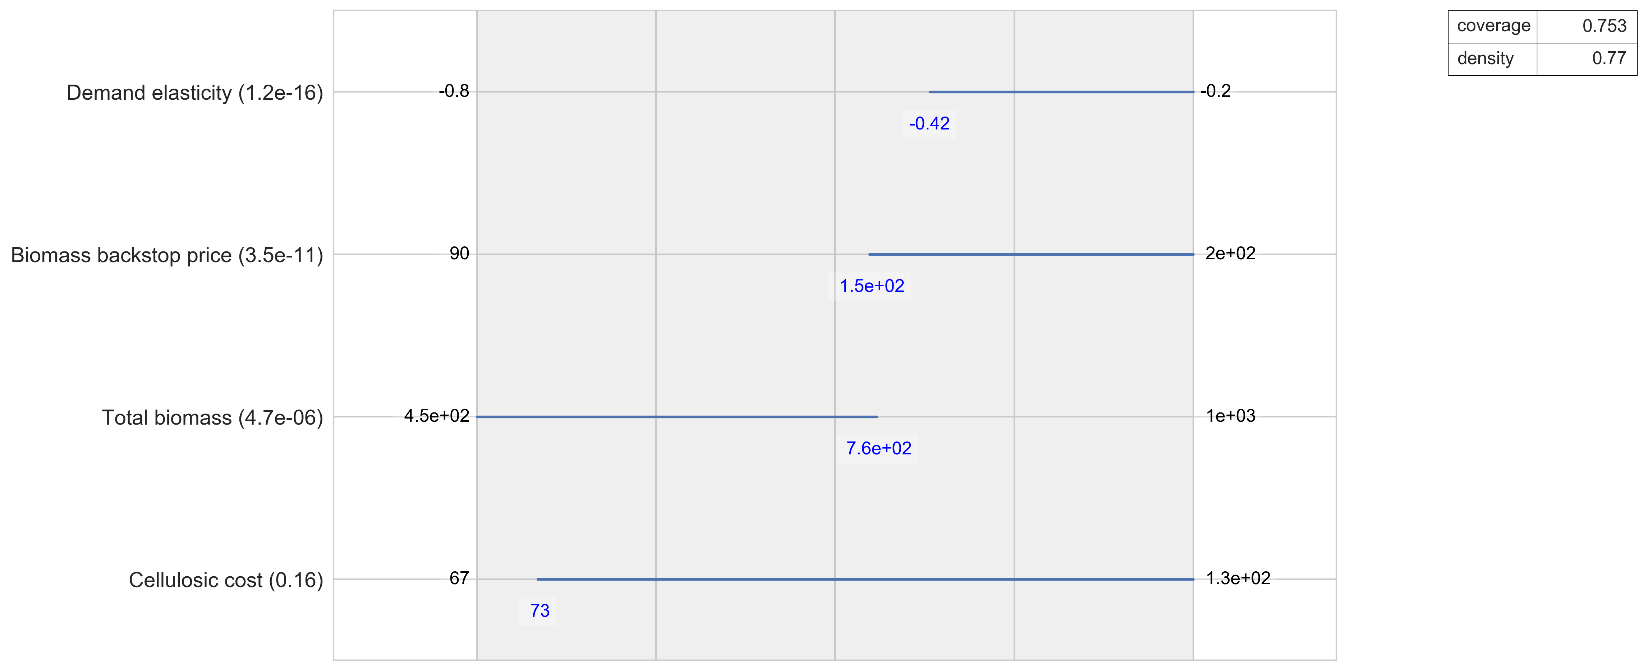

Slide 36
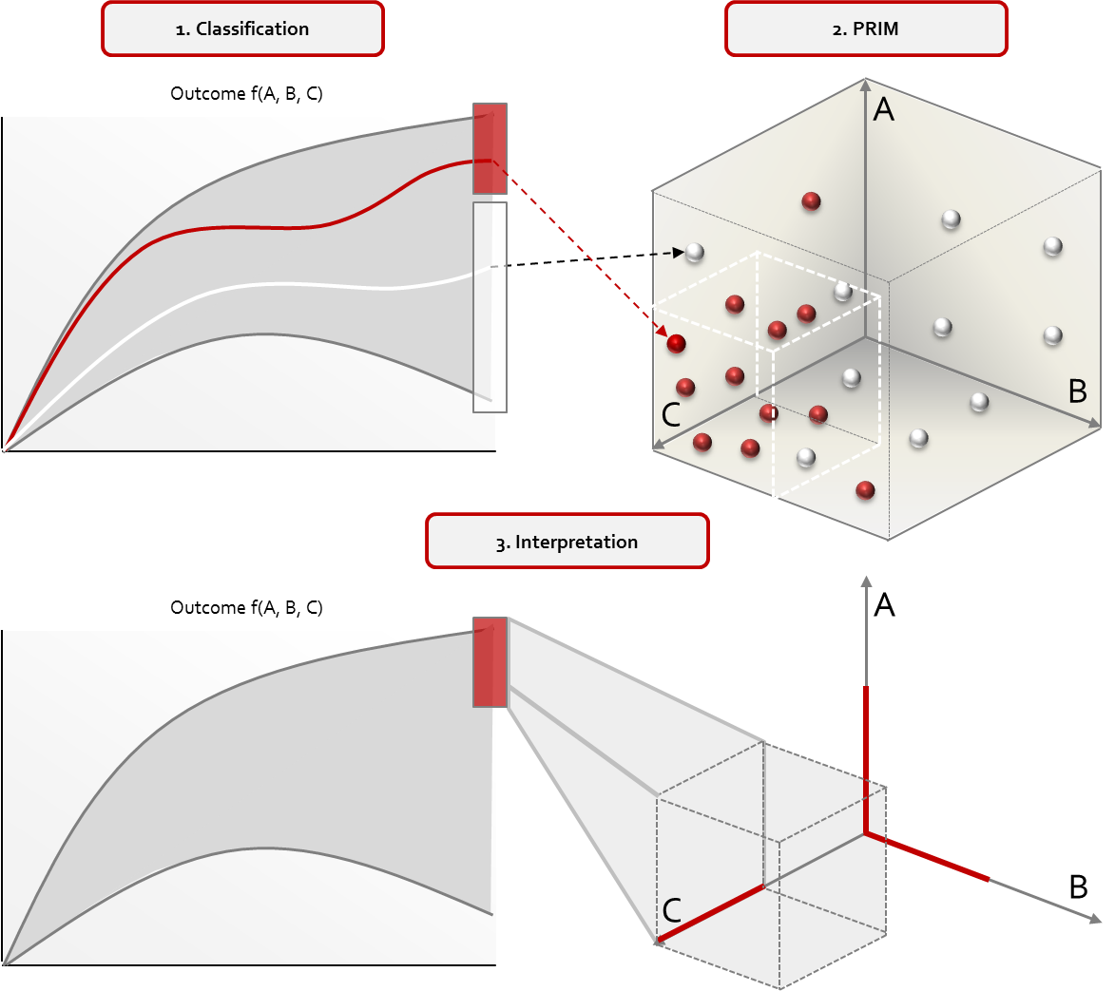
Scenario Discovery

Slide 37
Scenario discovery for designing adaptation pathways
Scenario discovery results can be understood as an n-dimensional generalization of adaptation tipping points
An adaptation tipping point is the level of an exogenous driver at which adaptation is required. These can be mapped to time for different scenarios
Scenario discovery finds n-dimensional boxes in the uncertainty space where a given policy fails
Some caveats
Not all exogenous drivers change over time
Mapping scenario discovery results onto the time axis is an open research question

Slide 38
Scenario Discovery excercise

Slide 39
Working with Google Colab
Go to Google Colab
upload RDM.ipynb
Uncomment first line: # !pip install ema_workbench\[recommended\]
Upload
100 experiments.tar.gz
10000 experiments.tar.gz
Go through the notebook
Note that you need to update the relative path references to both datafiles from "./data/10000 experiments.tar.gz” to "./10000 experiments.tar.gz”

Slide 40
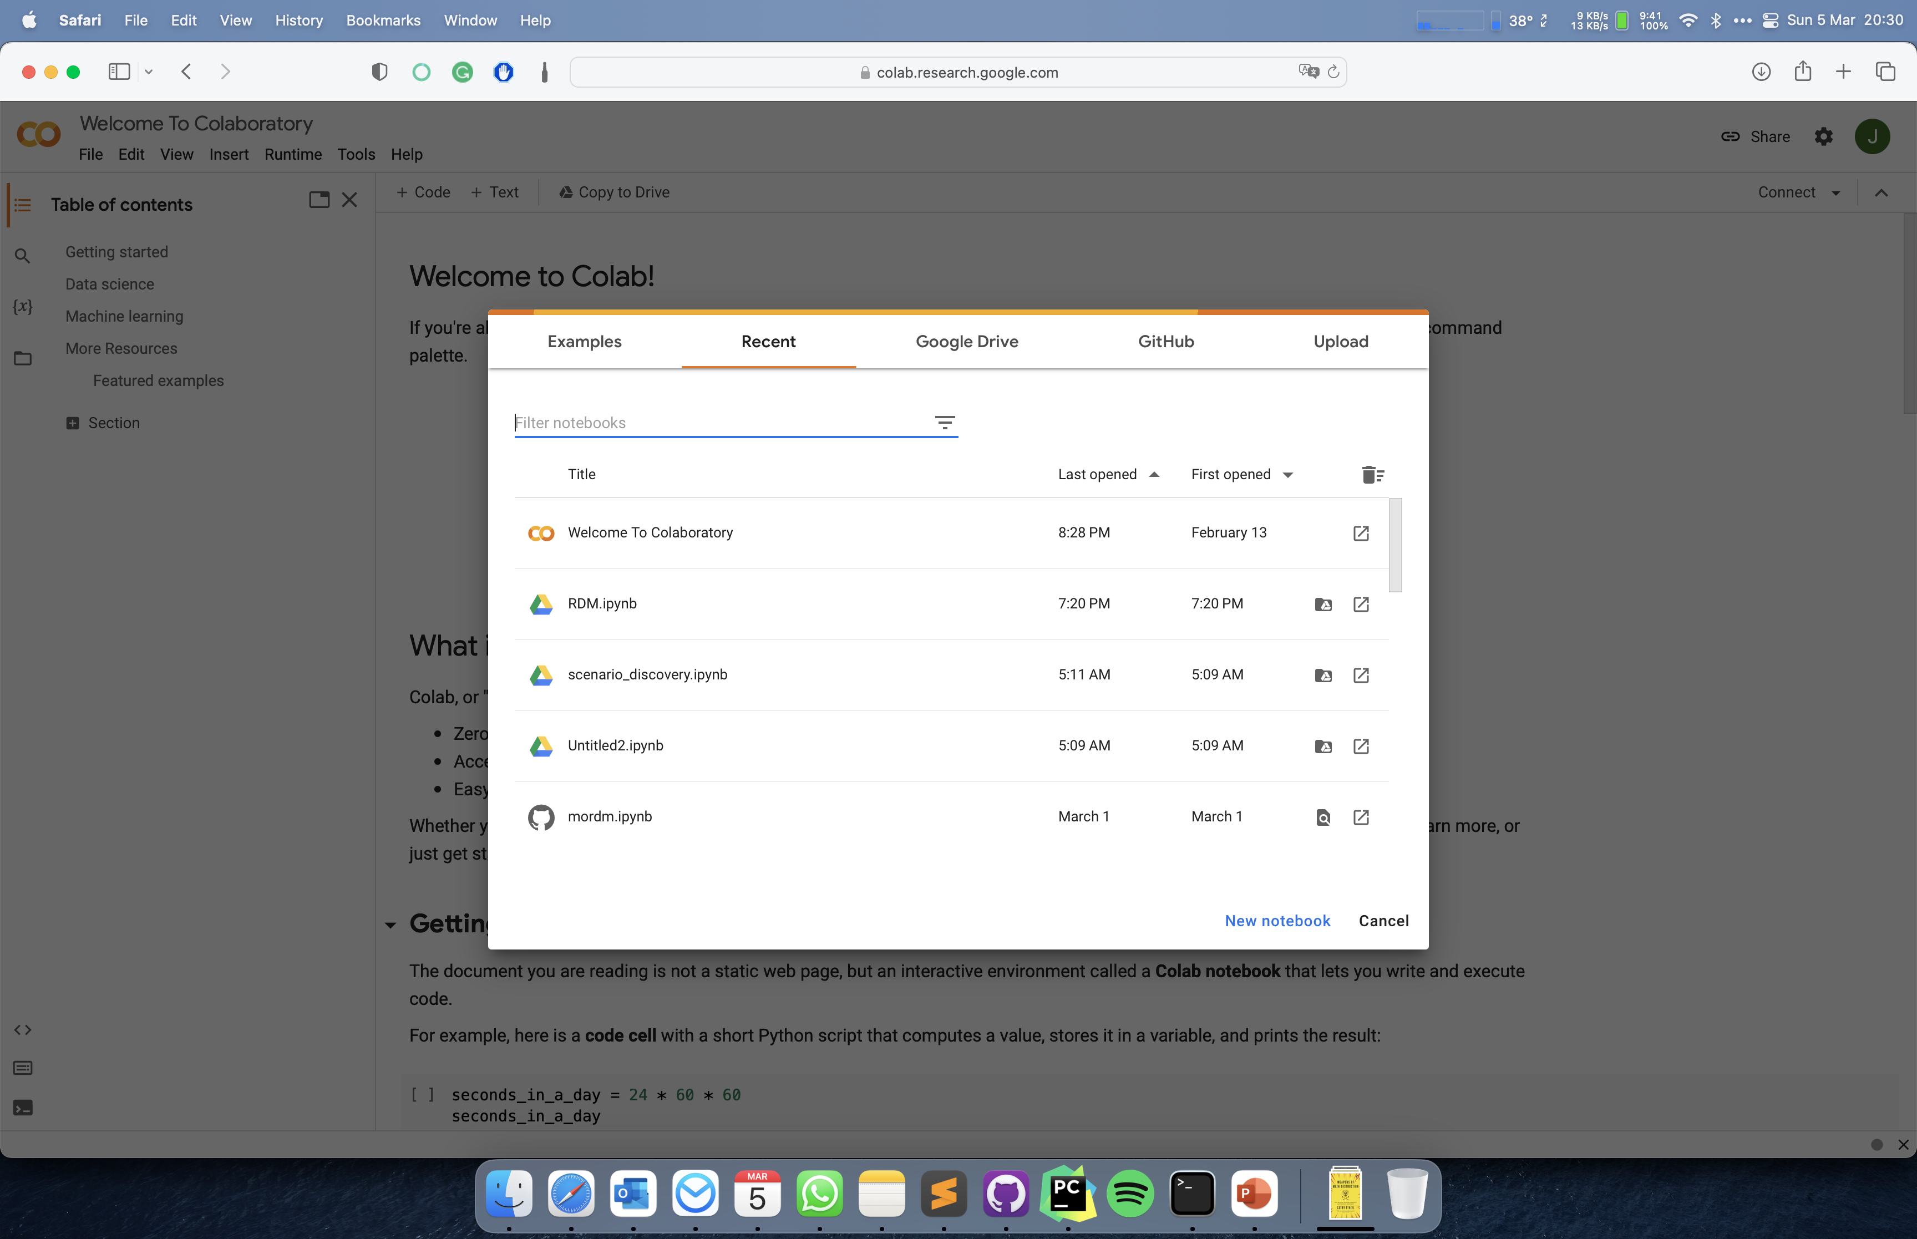
Upload scenario discovery.ipynb

Slide 41
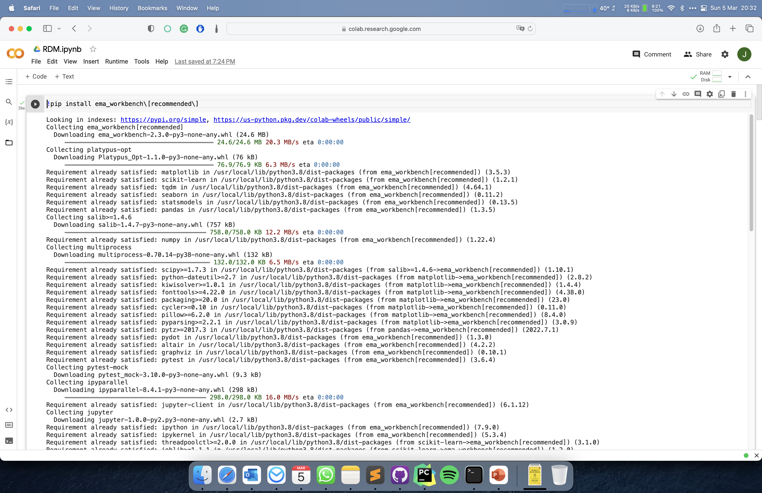
Open file viewer

Slide 42
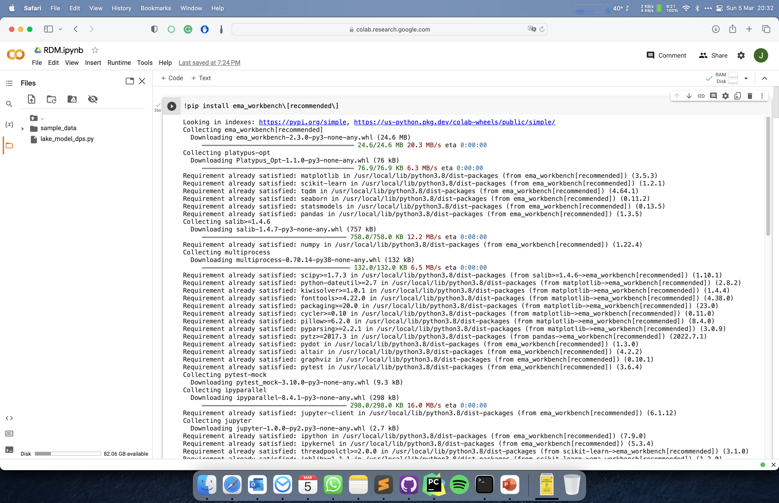
Click upload files

Slide 43
Introduction to RDM

Slide 44
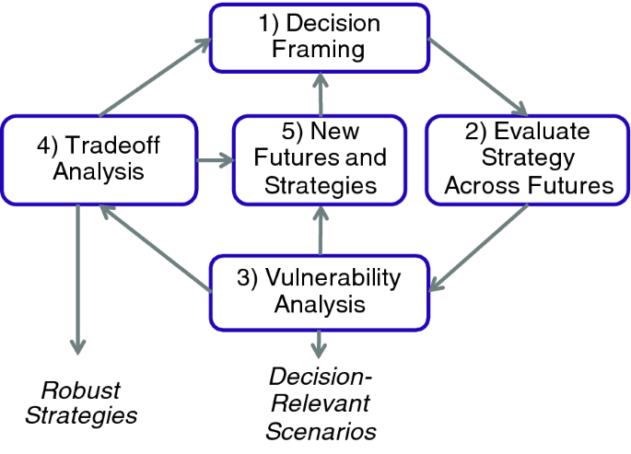
Robust Decision Making
Robust decision making is the process of using computer simulations to iteratively stress test candidate strategies
Decision Framing: structure the decision problem using the XLRM framework
Evaluate strategy across futures: explore behavior of modeled system across the uncertainties for all outcomes of interest, for one or more candidate strategies
Vulnerability analysis: scenario discovery
Tradeoff analysis: if vulnerabilities are limited analyse robustness tradeoffs amongst objectives
New futures and strategies: based on interpretation of 3 and 4, refine XLRM setup

Slide 45
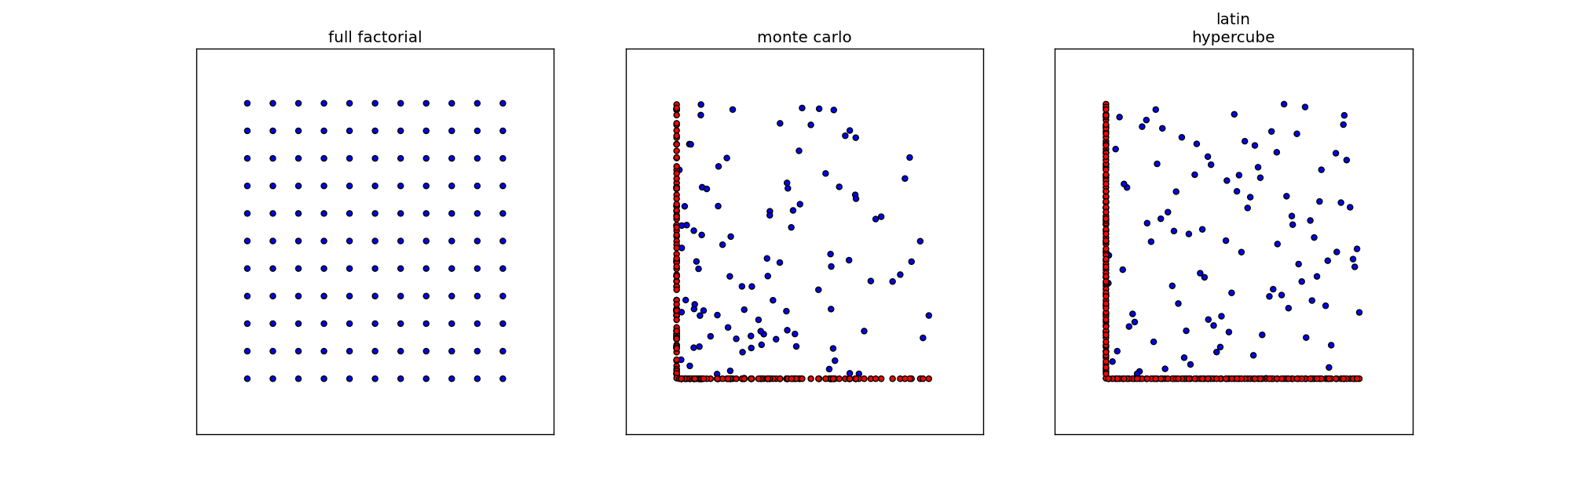
Experimental designs
Notes:
Figures show three sampling strategies with same number of samples (100)
For latin hypercube and monte carlo the red dots show the difference
Problem with full factorial is combinatory explosion.
Problem with lhs is generating it for many cases is memory intensive

Slide 46
RDM exercise

Slide 47
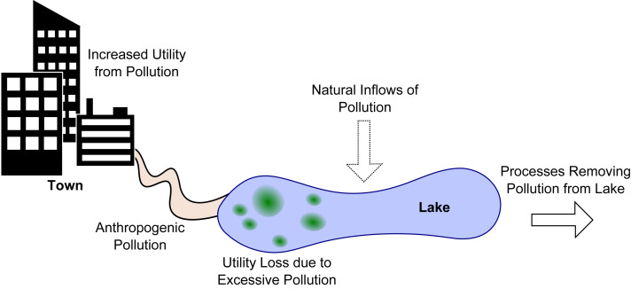
Shallow lake problem
How much anthropogenic pollution to release into the lake, while avoiding that the lake tips into an irreversible eutrophic state?
Adaptive version: what is a state based control rule that tells how much can be released?
Hadka et al (2015). 10.1016/j.envsoft.2015.07.014.

Slide 48
Workflow
Connect model to the workbench
X: uncertainties
L: levers which parameterize the control rule
R: model of the shallow lake
M: outcomes of interest
Develop basic system understanding by exploring the behavior of the system for one or more basic policies (i.e. control rules)
Optimize policies for a reference scenario
Re-evaluate (selected) policies over a much larger ensemble of scenarios
Analyze robustness and vulnerabilities (i.e., scenario discovery)
Iterate if necessary

Slide 49
Shift from RDM to MORDM
What if you do not have discrete and distinct options but rather varous (continuous) design variables?

Slide 50
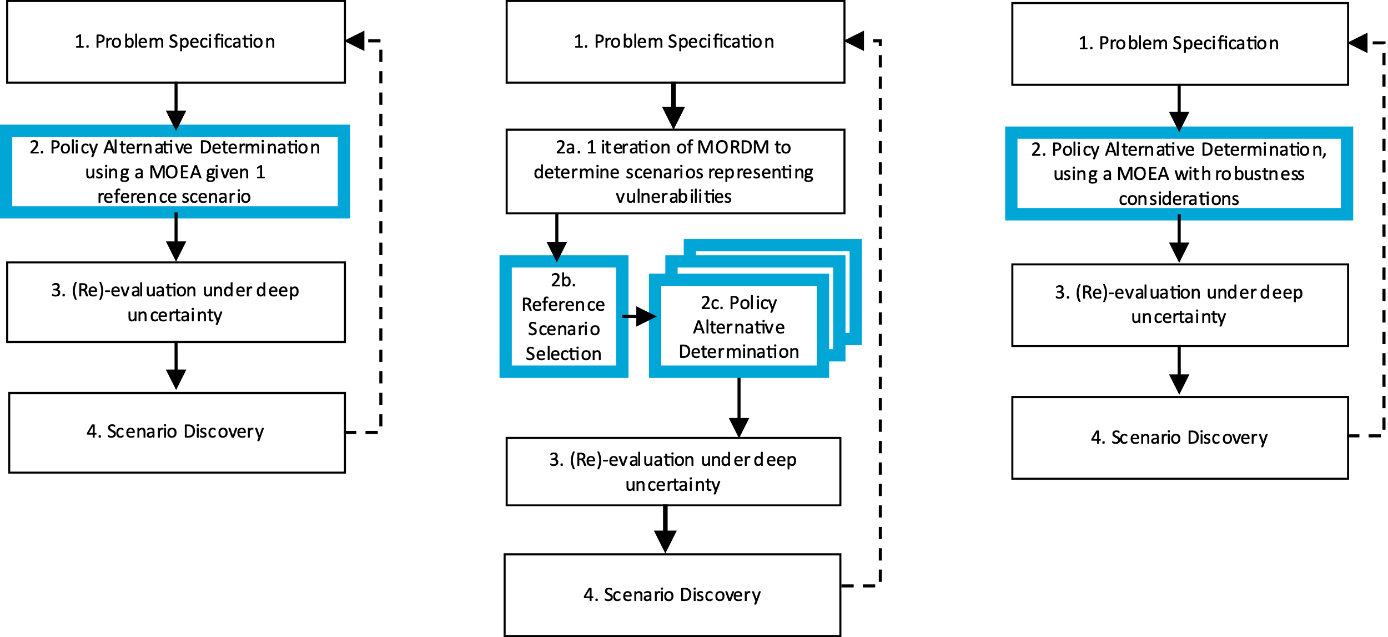
Robust decision making frameworks

Slide 51
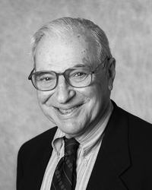
Arrow’s impossibility theorem
Kenneth Arrow, in 1950, demonstrated that there is no perfect voting procedure, it is either dictatorial or inherently unfair.

Slide 52
Arrow’s impossibility theorem
Individual preferences are ranked preferences (i.e. ordinal utility)
$A≻B≻C$
The goal is to arrive at an aggregate preference order of options given the individual preferences

Slide 53
Arrow’s impossibility theorem
Any voting procedure should be
1) Non-dictatorial: there is no single individual who’s preferences determine the aggregate preferences
2) Universal (complete ranking and deterministic): the final aggregate ranking should be complete, so no ties, and given a particular set of preferences of individuals always produce the same aggregate ranking
3) Independence of irrelevant alternatives: the preference relation between options A and B should not change if an option C is introduced which is always ranked lower than A and B
4) Pareto efficient: if option A is preferred by every individual over option B, than in the aggregate ranking option A should also be preferred over option B

Slide 54
Battling Arrow’s paradox
How can we account for Arrow’s paradox in any policy analytic activity?
Work with multiple objectives
Avoid the temptation to produce a complete ranking
Explore over alternative ways of formulating / framing a problem
Explore over alternative ways of aggregating over time and over scenarios
Key message: the policy analytic activity aims at helping decision makers understand the consequences of decision alternatives, and not to identify the best decision alternative

Slide 55
Pareto optimality
Premise: “A solution is Pareto optimal when improvements in one objective would degrade the performance in at least another objective”
Purpose: To rank alternatives in multi-objective problems.

Slide 56
Pareto dominance
A
Objective 2
B
C
Objective 1

Slide 57
Pareto dominance
A
Objective 2
B
C
D
Objective 1

Slide 58
Pareto dominance
A
Objective 2
B
C
D
Objective 1

Slide 59

Genetic Algorithms (GA)
Proposed in the 1970s by John Holland
Chromosome: Bit-string encoded candidate solution (nowadays other encoding forms are possible)
Gene: Each bit of the solution
A chromosome could represent the value of one or more parameters in your algorithm/system, e.g. the length of a robot arm, the value of weights in your neural network, the ids of operations you need to execute in a sequence…

Slide 60
John Holland—GA’s as Complex Adaptive Systems
Why simulate evolution for optimization?
Requires only distinguish “functional benefits” of adaptations
“Performance-based Random Process”: does not require detailed problem information (i.e., derivatives) and all pathways may be reachable
Breadth of application (real/discrete choices, uncertainty, nonlinearity)
Simple to link to complex simulations

Slide 61
Basic structure of an MOEA
population = initialize_population(population_size)
evaluate_objective_function(population)
non_dominated_sort(population)
selected = select_parents(population, population_size)
children = crossover_and_mutate(selected, p_crossover,p_mutation)
while(not stopping_condition()):
evaluate_objective_function(children)
union = population+children
non_dominated_sort(union)
selected = select_parents(union, population_size)
population = children
children = crossover_and_mutate(selected, p_crossover, p_mutation)

Slide 62
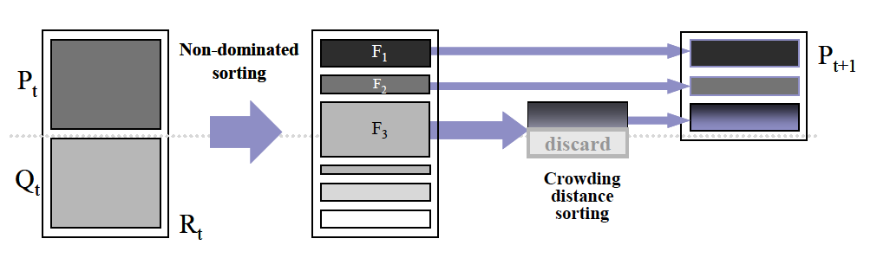
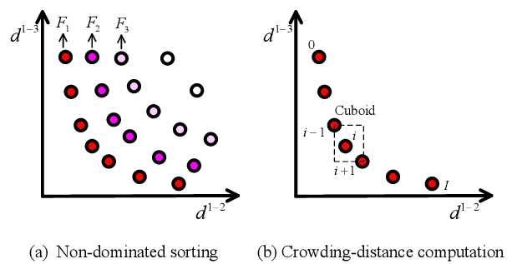
NSGAII (classic, but outdated)
1) Initial population
3) Rank the fitness of the population
Parent
population
2) Genetic
Operators:
Selection+
Mutation+
Crossover
Offspring
population
Key components:
1) Non dominated sorting
2) Crowding indicator for diversity maintenance

Slide 63
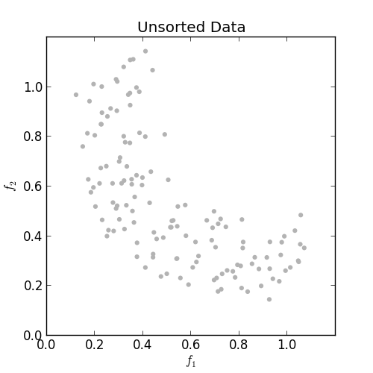
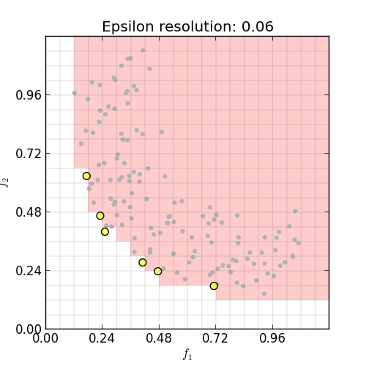
Epsilon dominance- better alternative to preserve diversity and scalability
Keeps the solution bounded and stable (important when increasing dimensionality)
Preserve diveristy
Taken from https://github.com/matthewjwoodruff/pareto.py

Slide 64
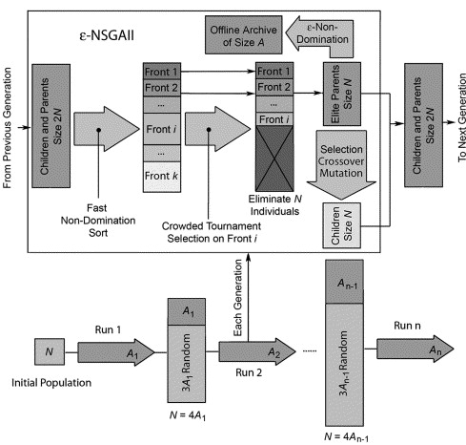
EPSILON-NSGAII
Key components:
Epsilon dominance for diversity maintenance
2) Auto-adaptive population sizing

Slide 65
MORDM excercise

Slide 66
Shallow lake problem
How much anthropogenic pollution to release into the lake, while avoiding that the lake tips into an irreversible eutrophic state?
Adaptive version: what is a state based control rule that tells how much can be released?
Hadka et al (2015). 10.1016/j.envsoft.2015.07.014.

Slide 67
Workflow
Connect model to the workbench
X: uncertainties
L: levers which parameterize the control rule
R: model of the shallow lake
M: outcomes of interest
Develop basic system understanding by exploring the behavior of the system for one or more basic policies (i.e. control rules)
Optimize policies for a reference scenario
Re-evaluate (selected) policies over a much larger ensemble of scenarios
Analyze robustness and vulnerabilities (i.e., scenario discovery)
Iterate if necessary

Slide 68
Robustness metrics

Slide 69
McPhail, C., et al (2018). "Robustness metrics: How are they calculated, when should they be used and why
do they give different results?" Earth's Future. 10.1002/2017EF000649

Slide 70
Robustness metrics
deeply uncertain factor 1
deeply uncertain factor 2
deeply uncertain factor 3
KPI’s per
scenario
Distribution per kpi over scenarios
policy
How to summarize the distribution over scenarios in (preferably) one number?
Robustness per kpi, or one robustness number per policy?
Figure adapted from Trindade et al. (2019) https://doi.org/10.1016/j.advwatres.2019.103442

Slide 71
3 families of robustness metrics
Satisficing robustness
Absolute: the observed performance of a policy in each scenario compared to an absolute performance threshold
Regret
Relative: the difference between the observed performance of a policy in each scenario and the performance of some reference policy for each scenario
Descriptive statistics
Characterizing the distribution of performance of a policy over the set of scenarios using one or more moments of the distribution

Slide 72
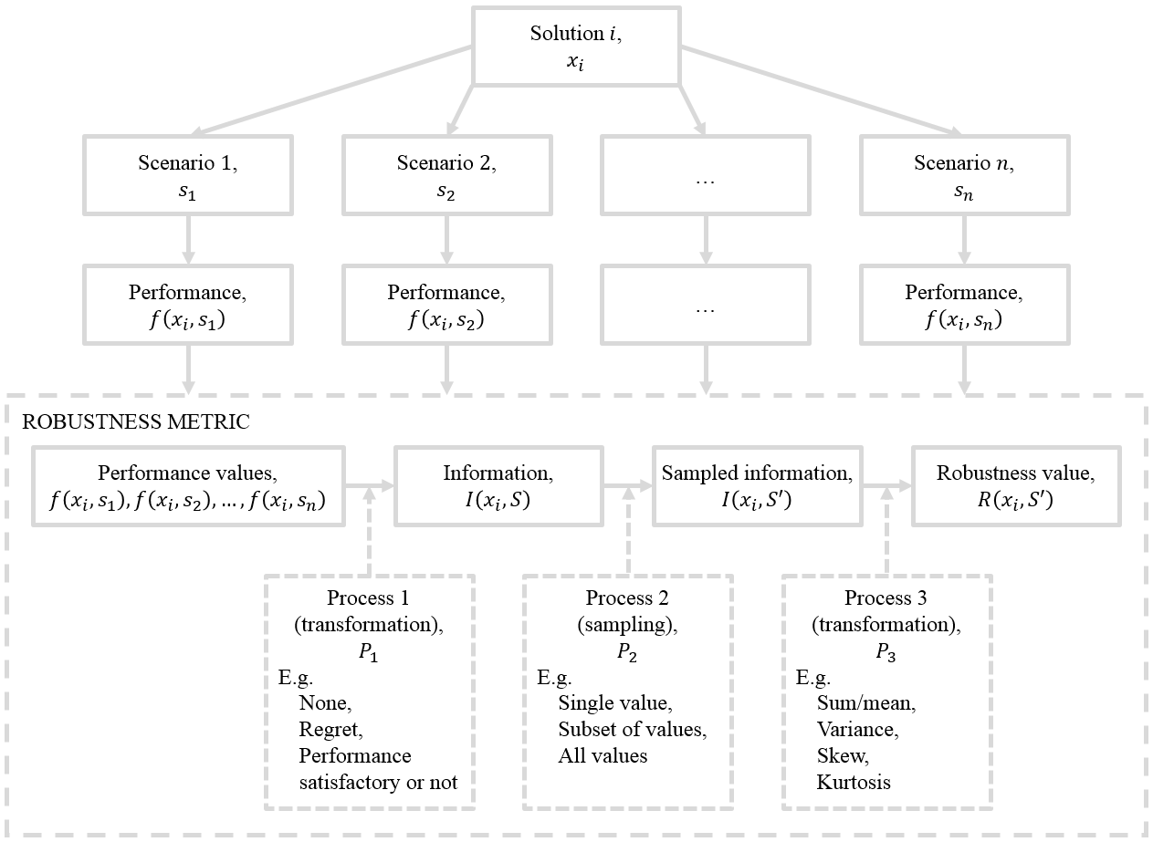
Robustness calculation
McPhail, C., et al (2018). "Robustness metrics: How are they calculated, when should they be used and why
do they give different results?" Earth's Future. 10.1002/2017EF000649

Slide 74
MORDM exercise continued

Slide 75
Some example applications of (MO)RDM

Slide 76

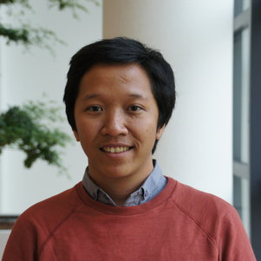

Income inequality in the Vietnam Mekong Delta
Bramka Arga Jafino
Maaike van Aalst
Notes:
Many talk about climate migration from the mekong
But real story is quite more complicated
So we created a simulation model to better understand what is happening and to identify possible interventions that address inequality

Slide 77
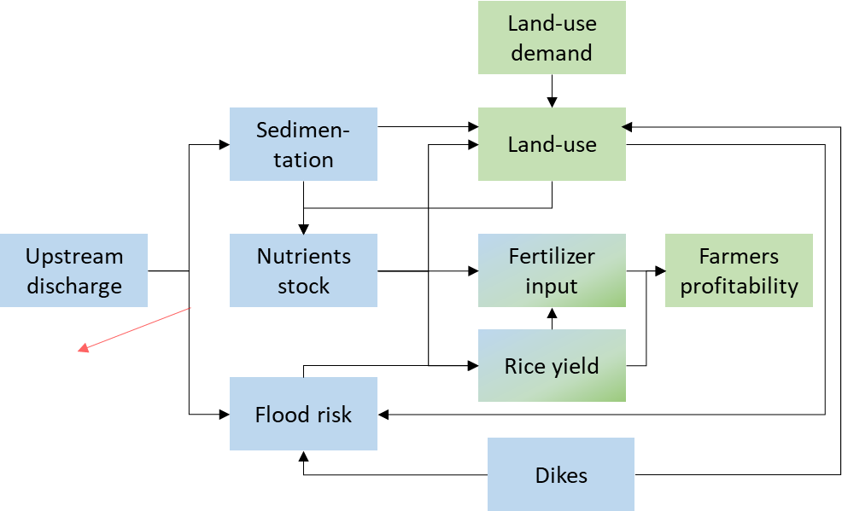
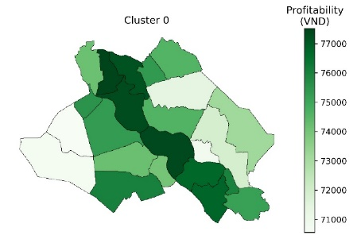
Adaptation policies
more high dikes
less high dikes
fertilizer subsidies
seed upgrade
Uncertainties
river discharge
upstream dam development
farming preferences
drought impacts
Performance indicators
District level profitability
Integrated assessment model
Notes:
Walk through the modeling work

Slide 78
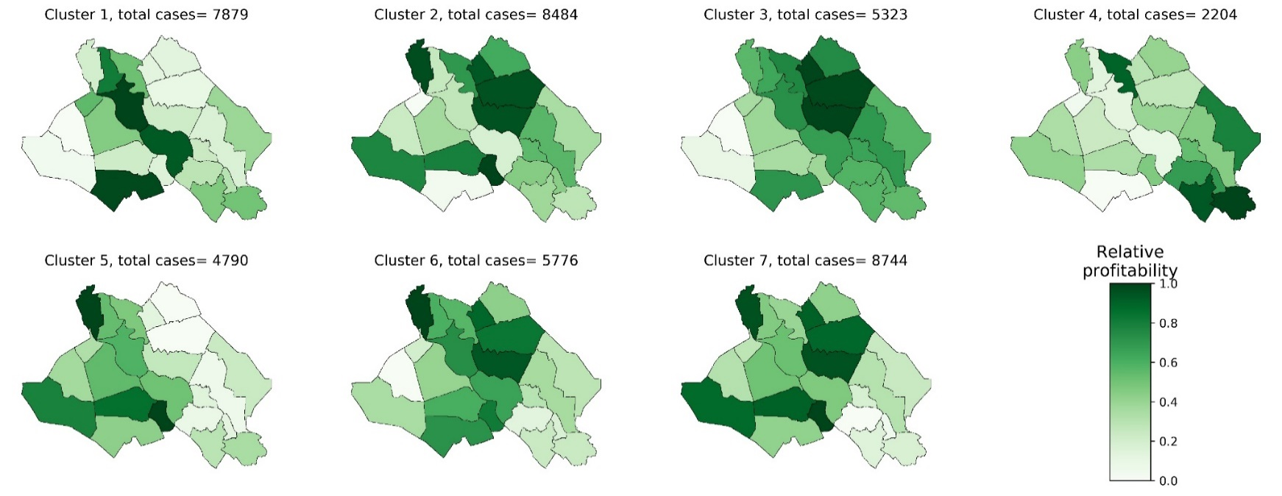

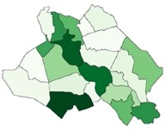
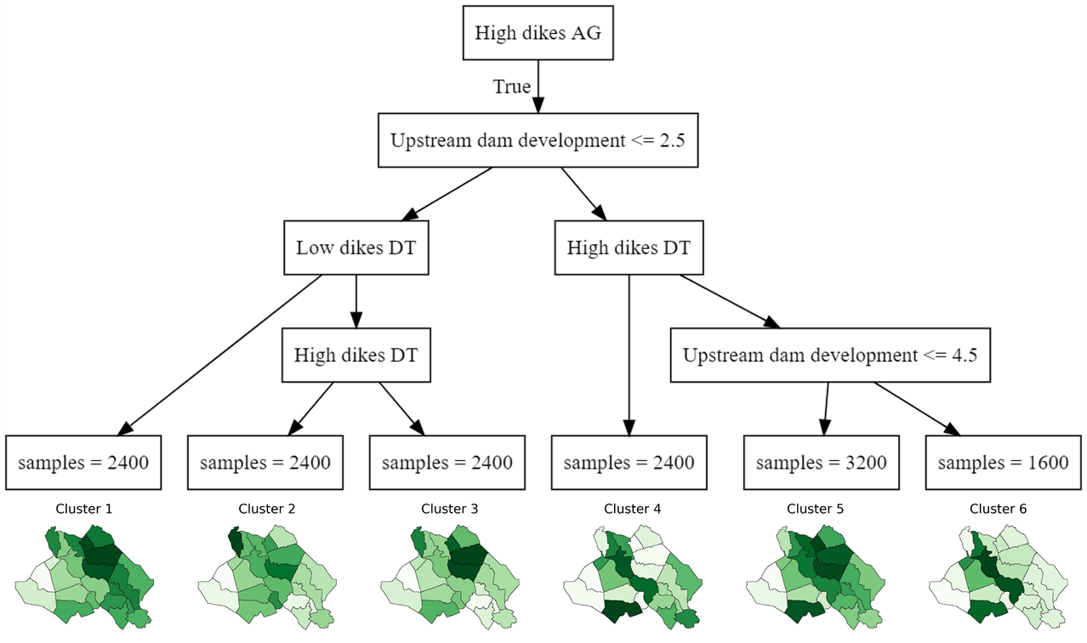
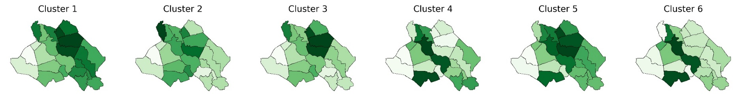
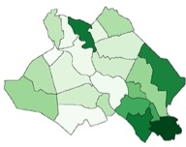
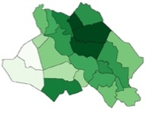
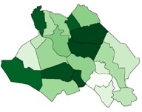
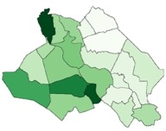
How can income patterns change?
43K scenarios
7 archetypical
income patterns
Classification tree mapping uncertainties and policies to types of income patterns

Slide 79
How can income patterns change?
43K scenarios
7 archetypical
income patterns
Classification tree mapping uncertainties and policies to types of income patterns

Slide 80
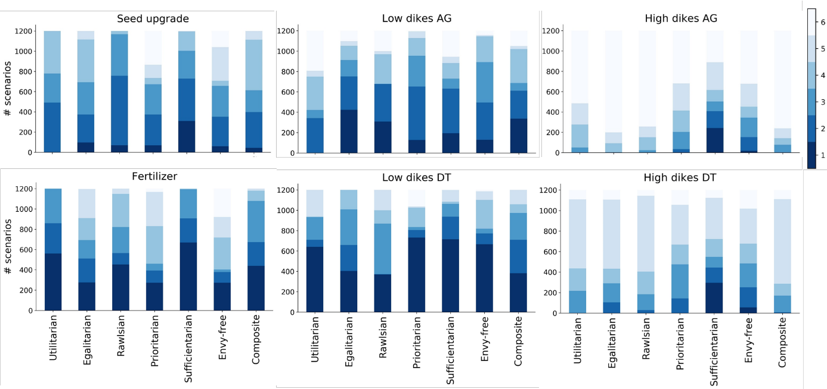
How sensitive are rankings to normative assumptions?

Slide 81
Research triangle

Slide 82
Closing remarks

Slide 83
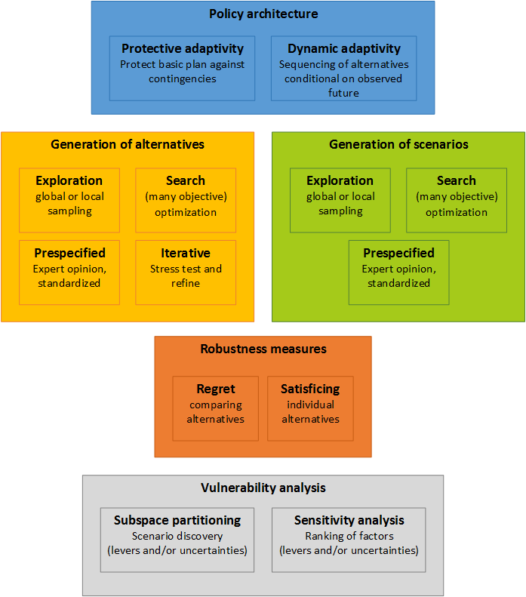
Kwakkel & Haasnoot (2018) Supporting decision making under deep uncertainty: a synthesis of approaches and techniques

